Slide 1
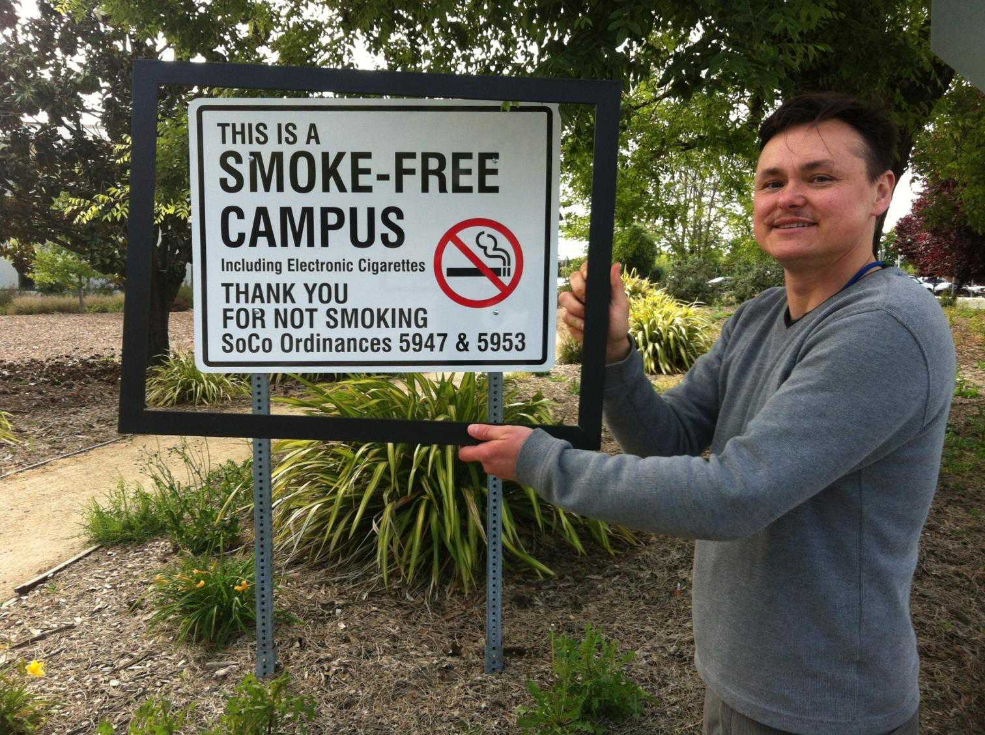
The Portrait helps guide the Board of Supervisors in its public health policy– recently expanding outdoor secondhand smoke protections to include e-cigarettes. Jay Macedo, Sonoma County DHS, Tobacco Prevention

Slide 2
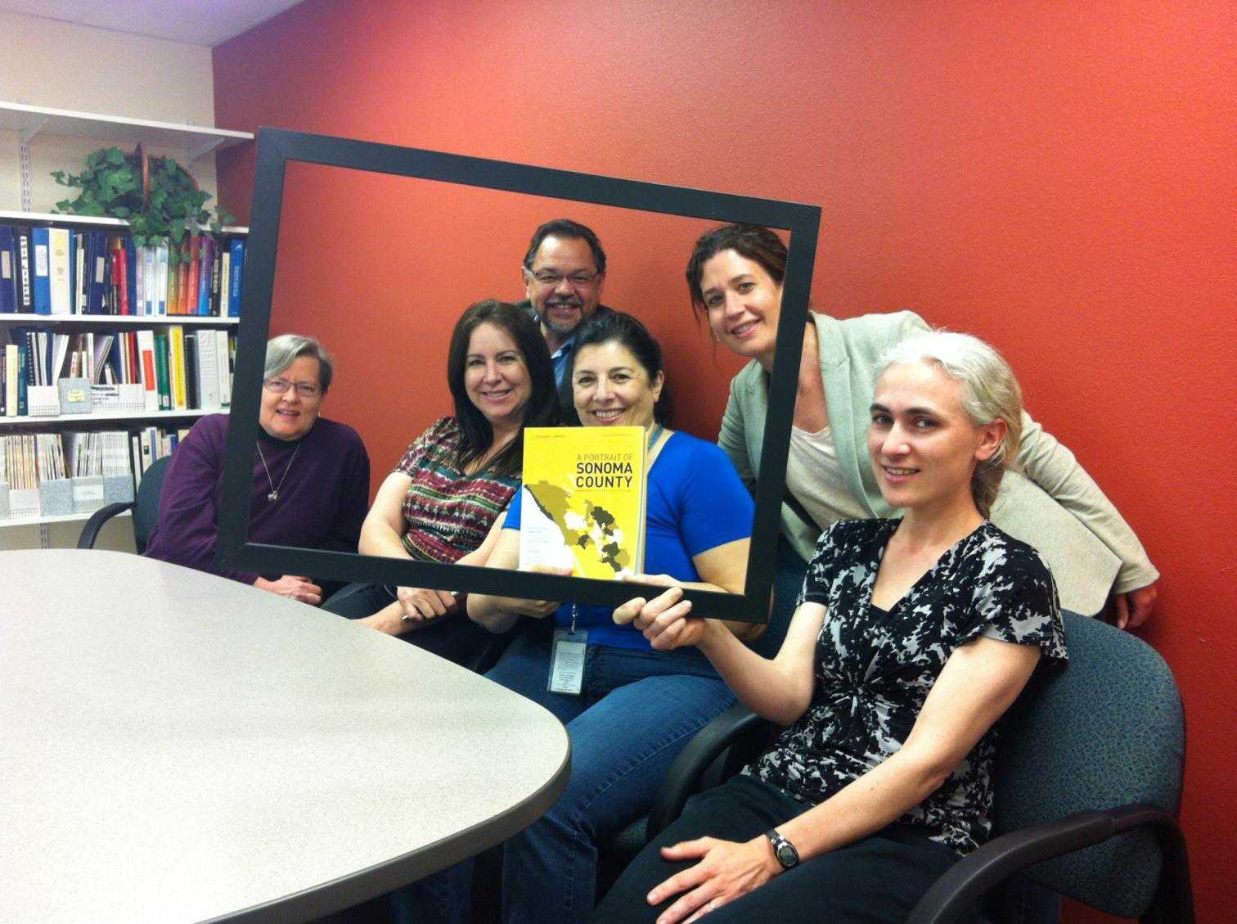
The Portrait helps First 5 tell its story. We’re working towards Universal Preschool, a key Portrait recommendation. First 5 Team, Sonoma County Department of Health Services

Slide 3
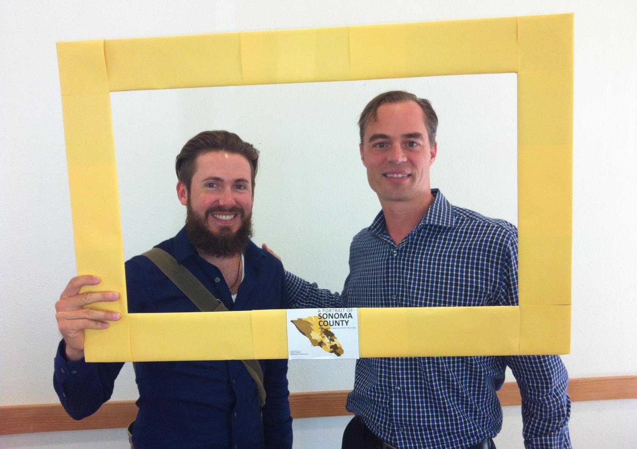
We used the Portrait during our Strategic Planning Process and identified opportunities to address disparities. We also wrote a letter in support of the County TRL and work closely with RRARA.
Jared Garrison-Jakel and Luke Entrup, West County Health Centers

Slide 4
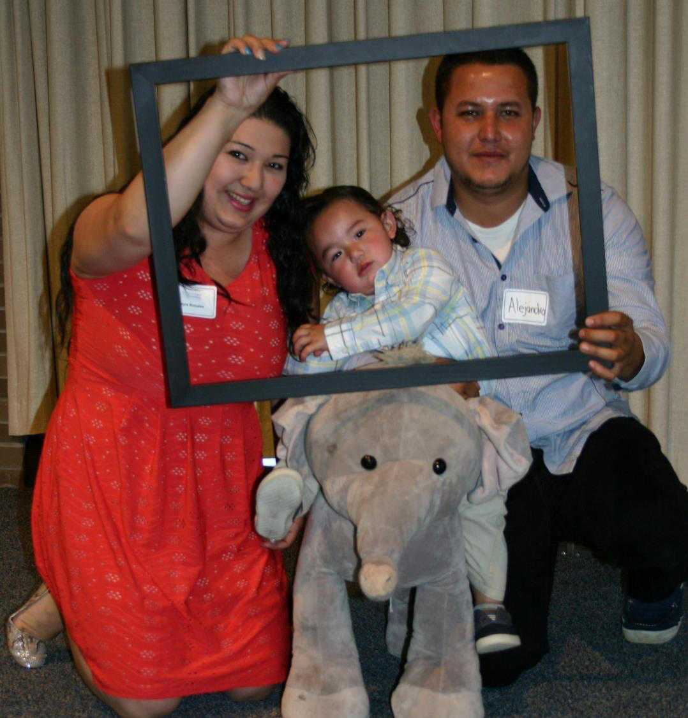
The Portrait helps us identify communities that will benefit most from evidence-based programs such as the Nurse Family Partnership, a nurse home visiting program for low-income, first time mothers.
Maternal Child and Adolescent Health Division, Sonoma County DHS

Slide 5
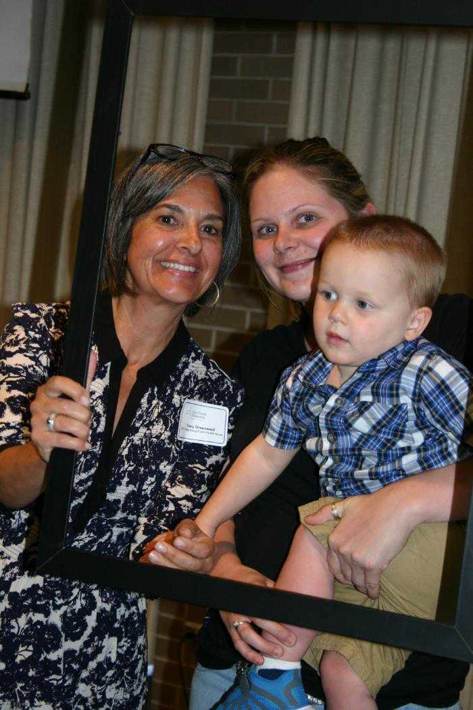
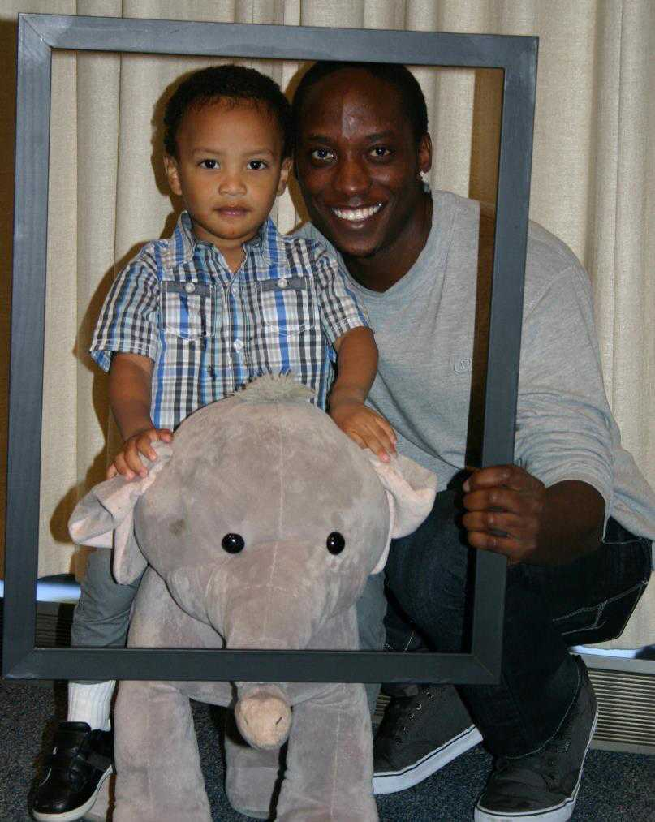
Jackson and Kingston, 2015 Nurse Family Partnership Graduates
The Portrait highlights the importance of early investments. We know that the first 1,000 days is when we can most positively influence the course of a young child’s life.

Slide 6
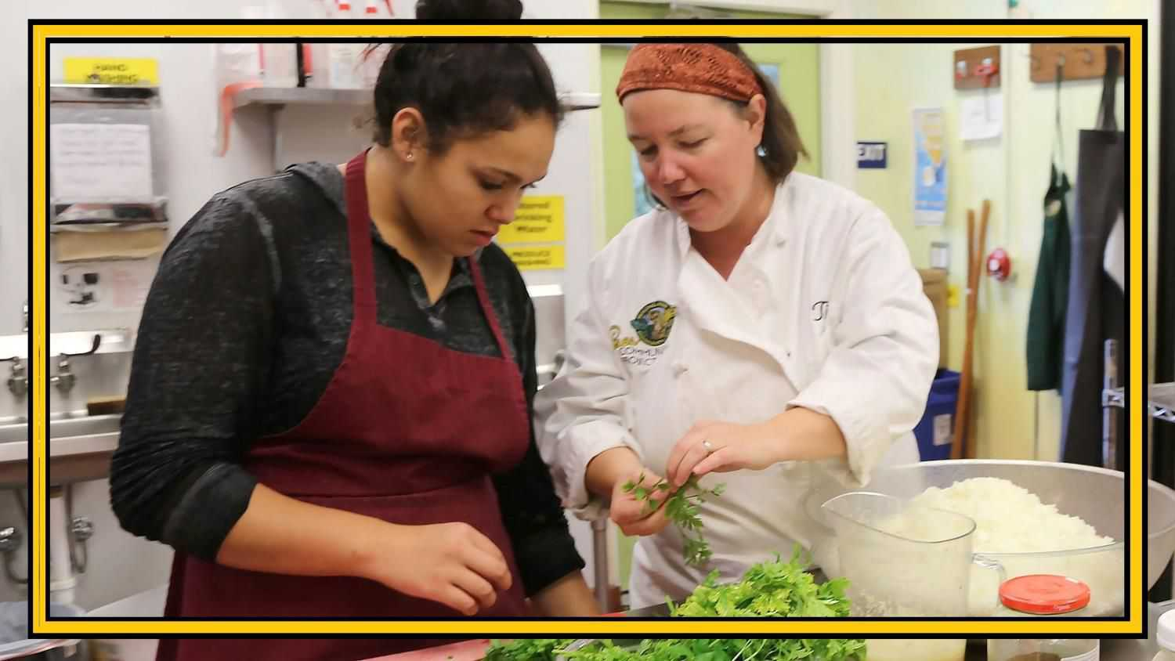
The Portrait influenced us to invest in a new program site at the SAY Dream Center to connect youth to their power to make a difference while building life, leadership and work skills. CERES Community Project

Slide 7
The Portrait helps train all St. Joseph Health new Sonoma County employees in how health happens in neighborhoods and
our work goes beyond our hospital walls. Matt Ingram, Director of Community Benefit, St. Joseph Health

Slide 8
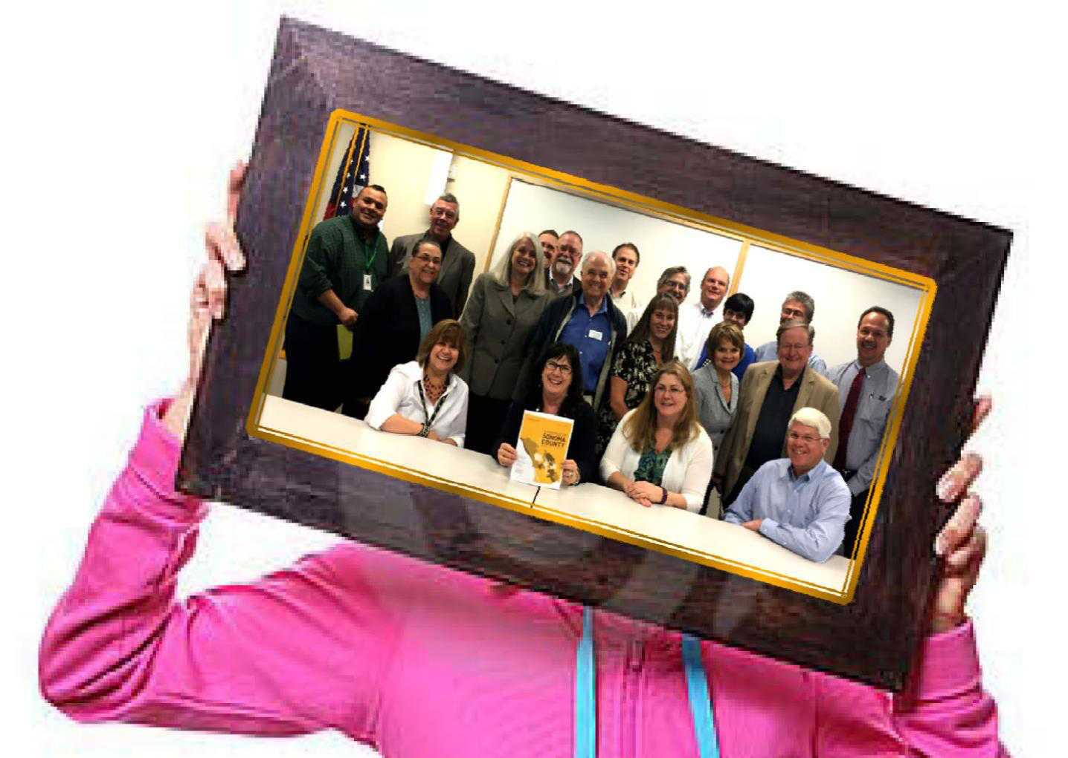
We lead an integrated workforce development system to ensure the County’s economic vitality and quality of life. The Portrait provides crucial information that helps define our work.
Sonoma County Workforce Investment Board(WIB)

Slide 9
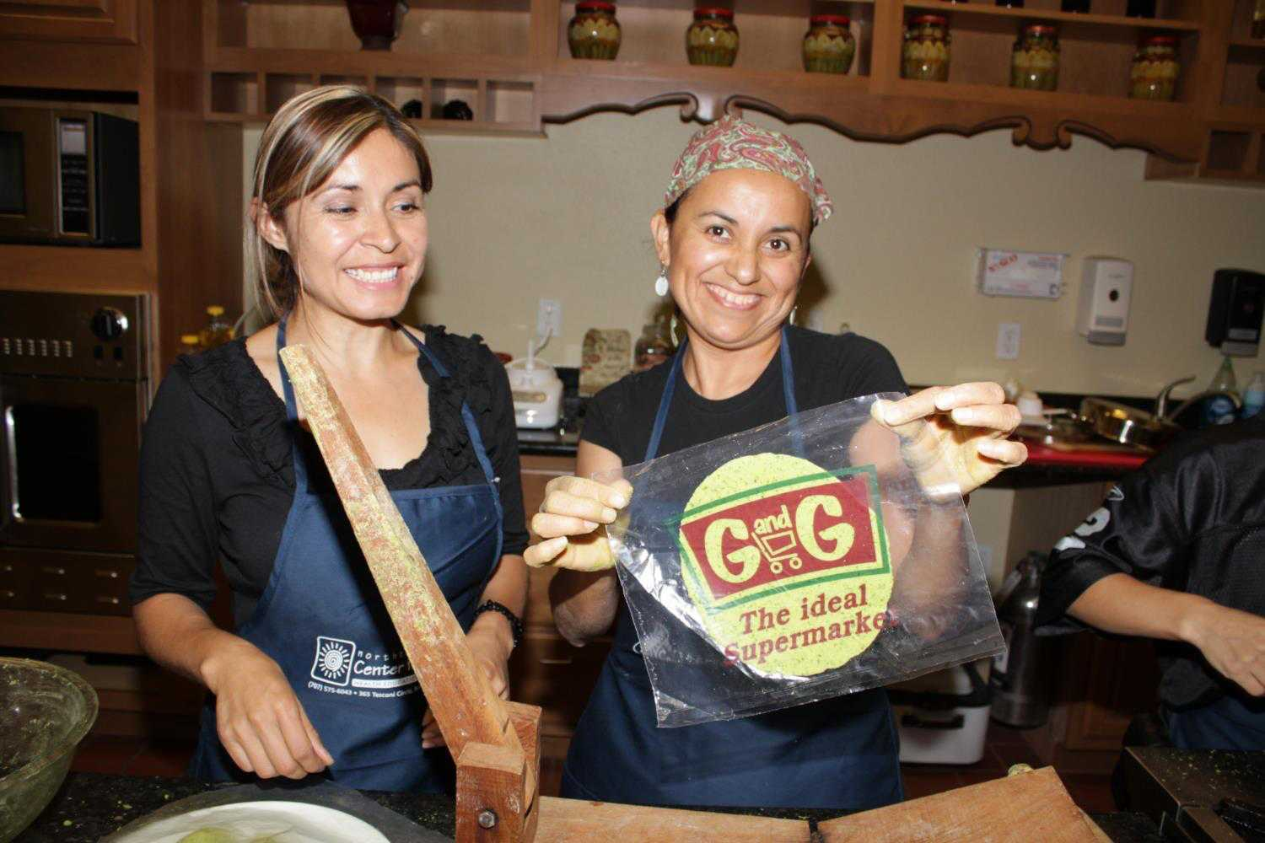
The Portrait reinforces the importance of our healthy cooking classes in Spanish to prevent diabetes and hypertension
Center for Well-Being

Slide 10
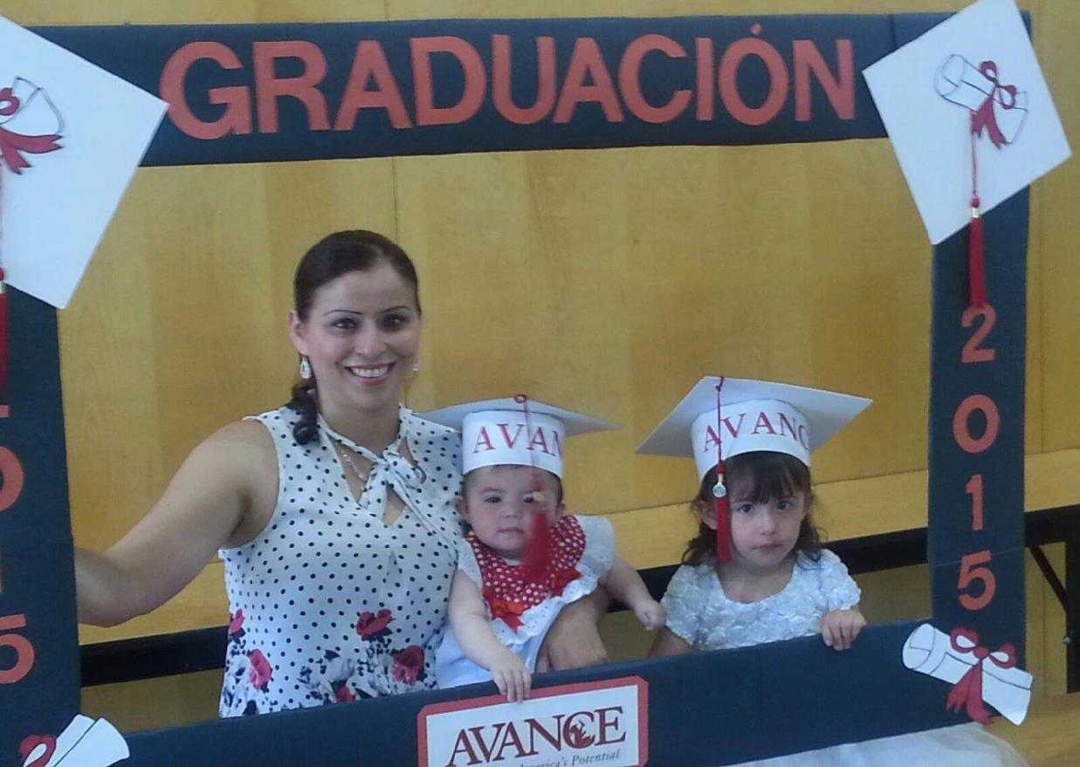
The Portrait highlights the importance of early childhood education. Our 9-month, evidence-based curriculum helps each child prepare to enter school and gives parents the tools to become their child’s 1st teacher.
AVANCE, Community Action Partnership of Sonoma County

Slide 11
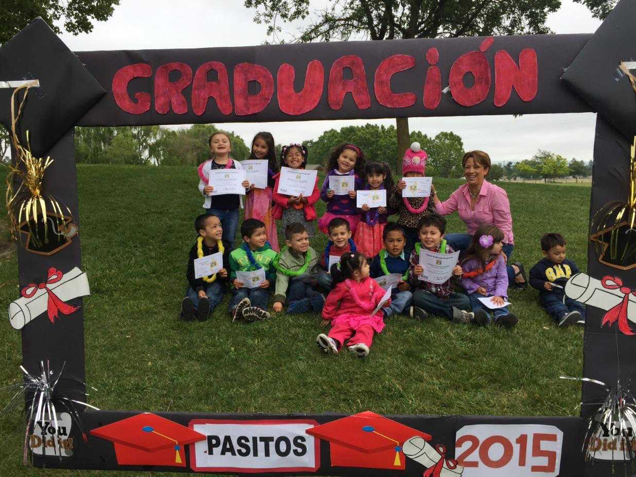
Also, the Pasitos Playgroup Program provides an engaging, structured learning environment for families with 3-4 year olds that promotes positive parent-child interactions with the goal of future school success. Pasitos, Community Action Partnership of Sonoma County

Slide 12
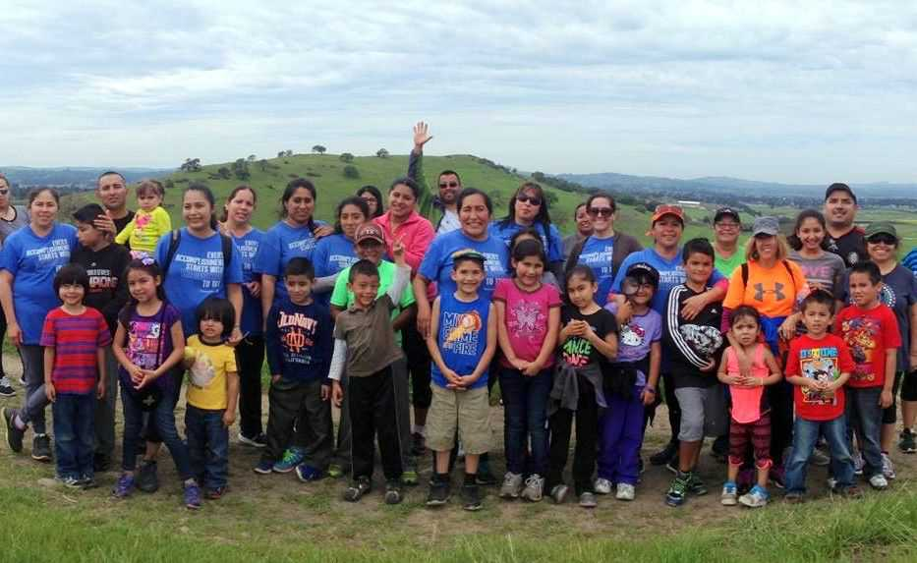
The Portrait helps us identify communities that can enjoy greater access to parks and helps us create programs to promote health and wellness, programs like the monthly Nuestros Parques hiking series.
Sonoma County Regional Parks

Slide 13
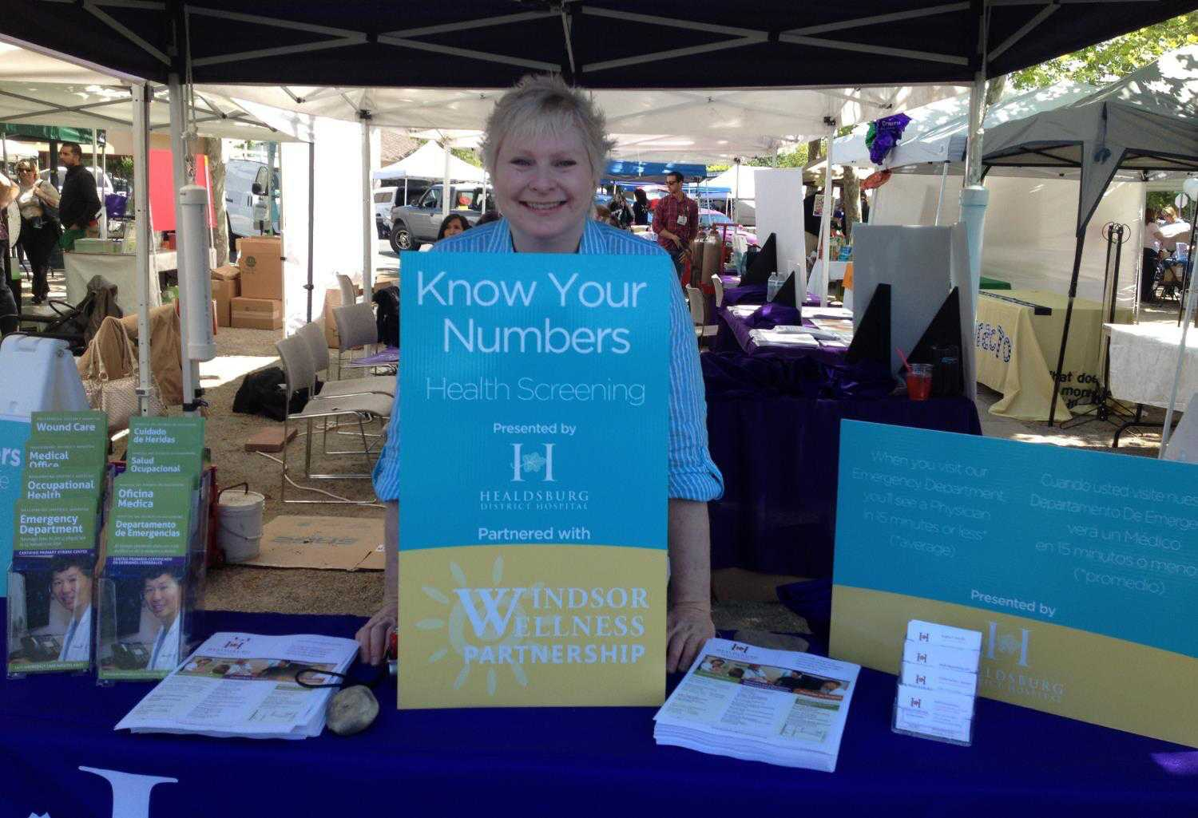
The Portrait helps us know where we can be most effective in our healthy food outlet and Know Your Numbers efforts.
Windsor Wellness Partnership

Slide 14
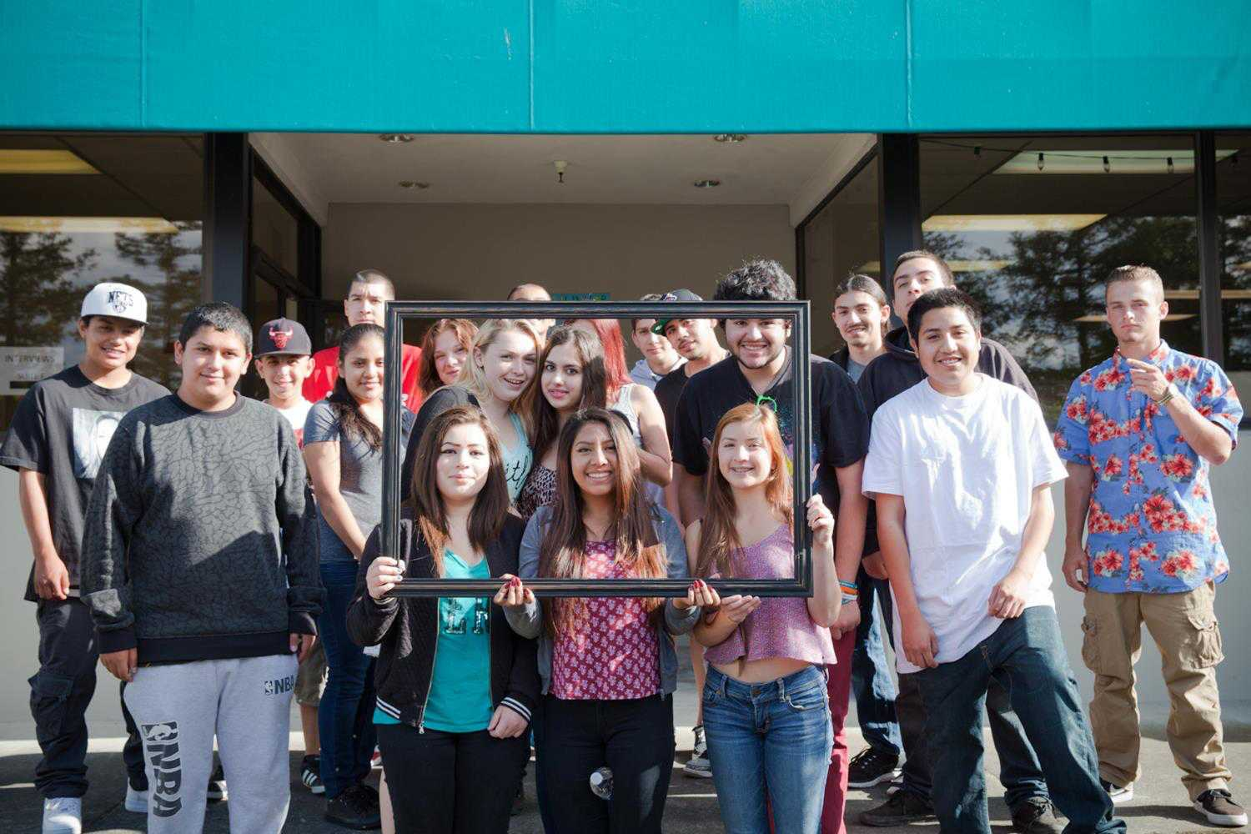
The Portrait shows the importance of connecting youth with the community. SAY is "reducing youth disconnection" by helping teens connect with local leaders, learn new job skills, and find employment
Social Advocates for Youth

Slide 15
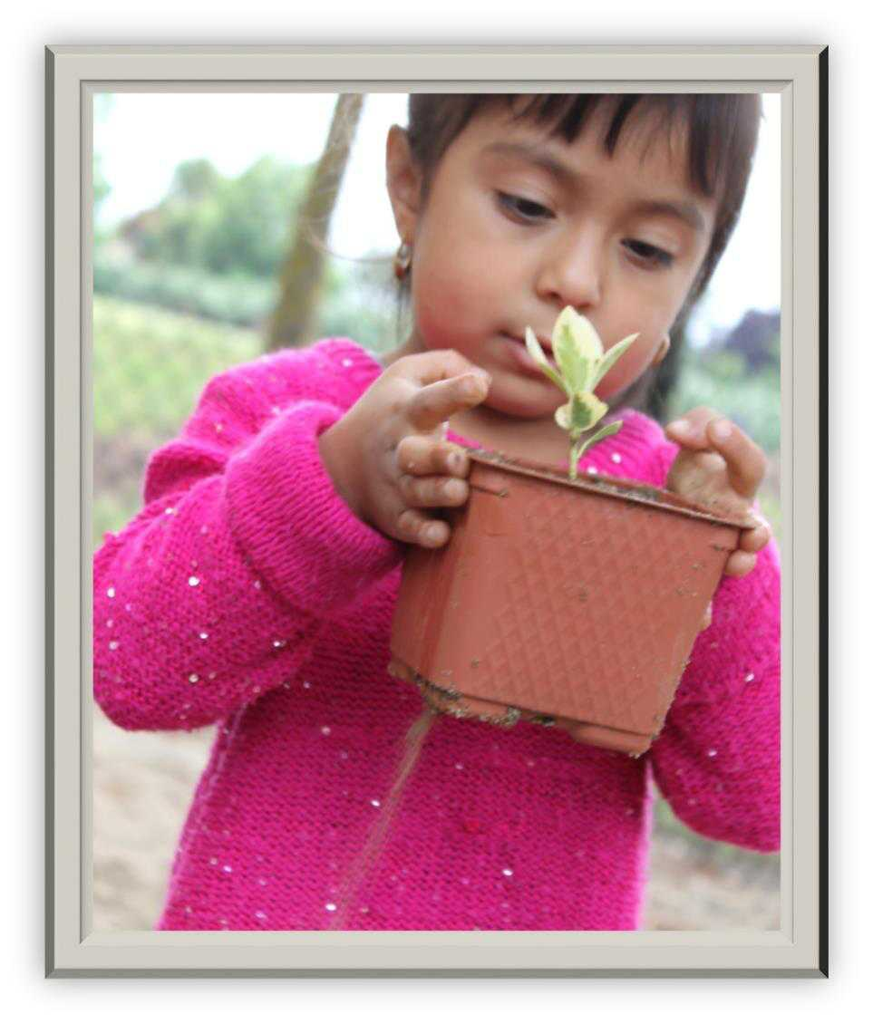
The Portrait has guided us in creating community partnerships with agencies that share our commitment to early investment. 4Cs and SSU collaborated on a community garden for the families of Gold Ridge Preschool, kicking off a lifetime of healthy choices! 4C’s

Slide 16
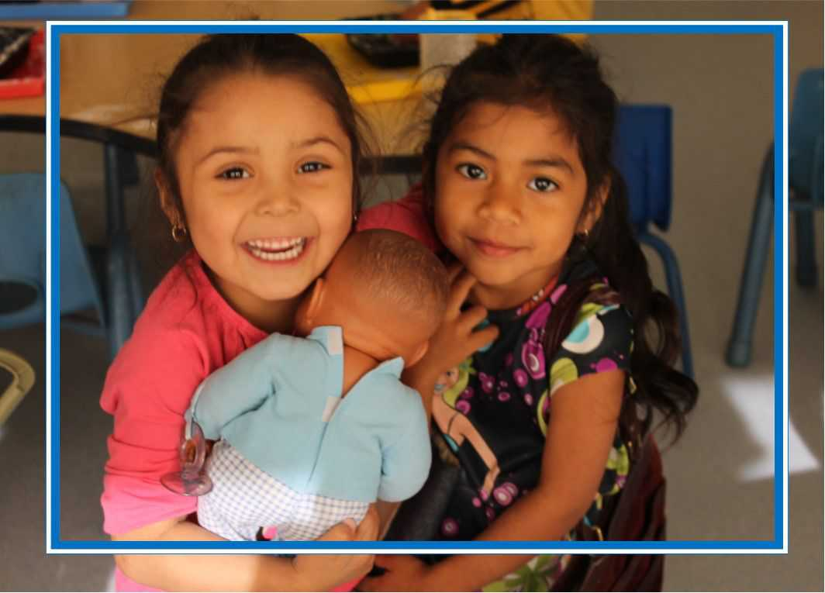
Portrait helped our agency extend our lease for Willow Creek Preschool with the City of Santa Rosa, securing quality early care and education for families living in a high priority community for another ten years!
4C’s

Slide 17
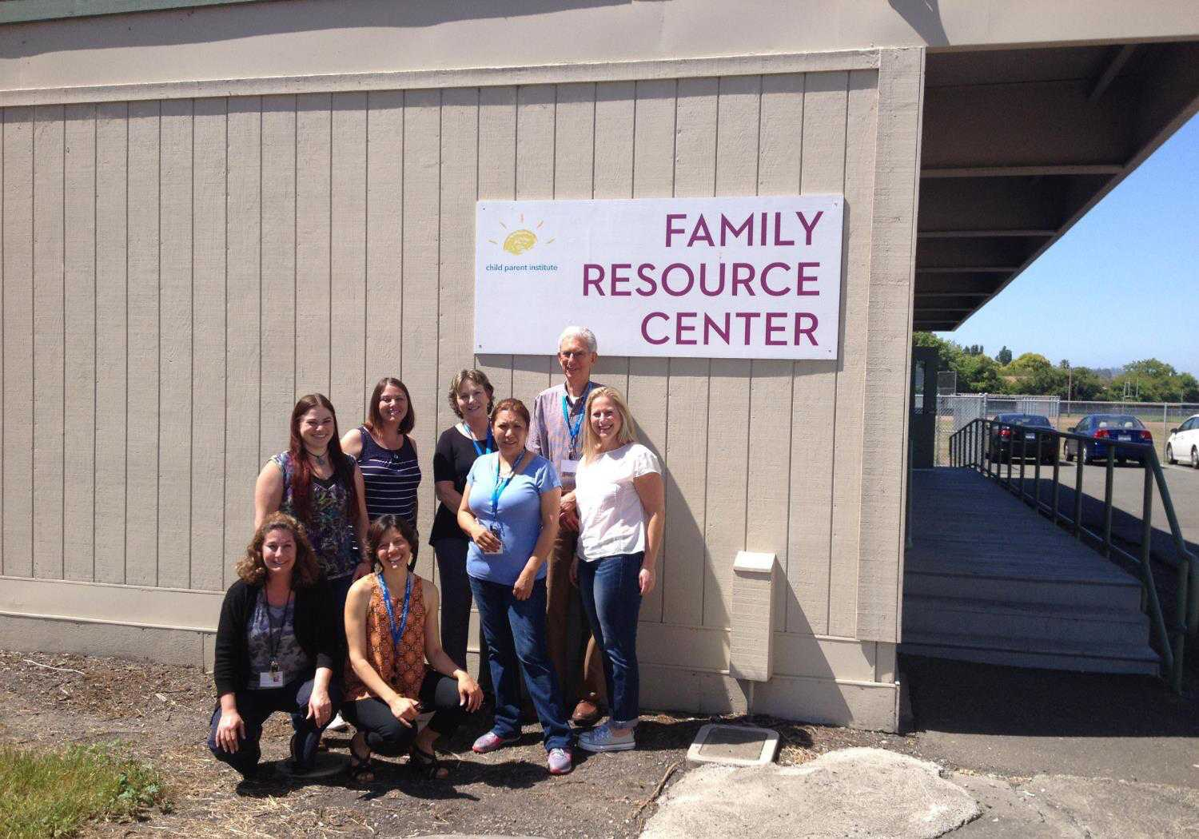
Thank you, Portrait of Sonoma County, for drawing attention to the needs of our community here in Rohnert Park
Child Parent Institute’s Family Resource Center

Slide 19
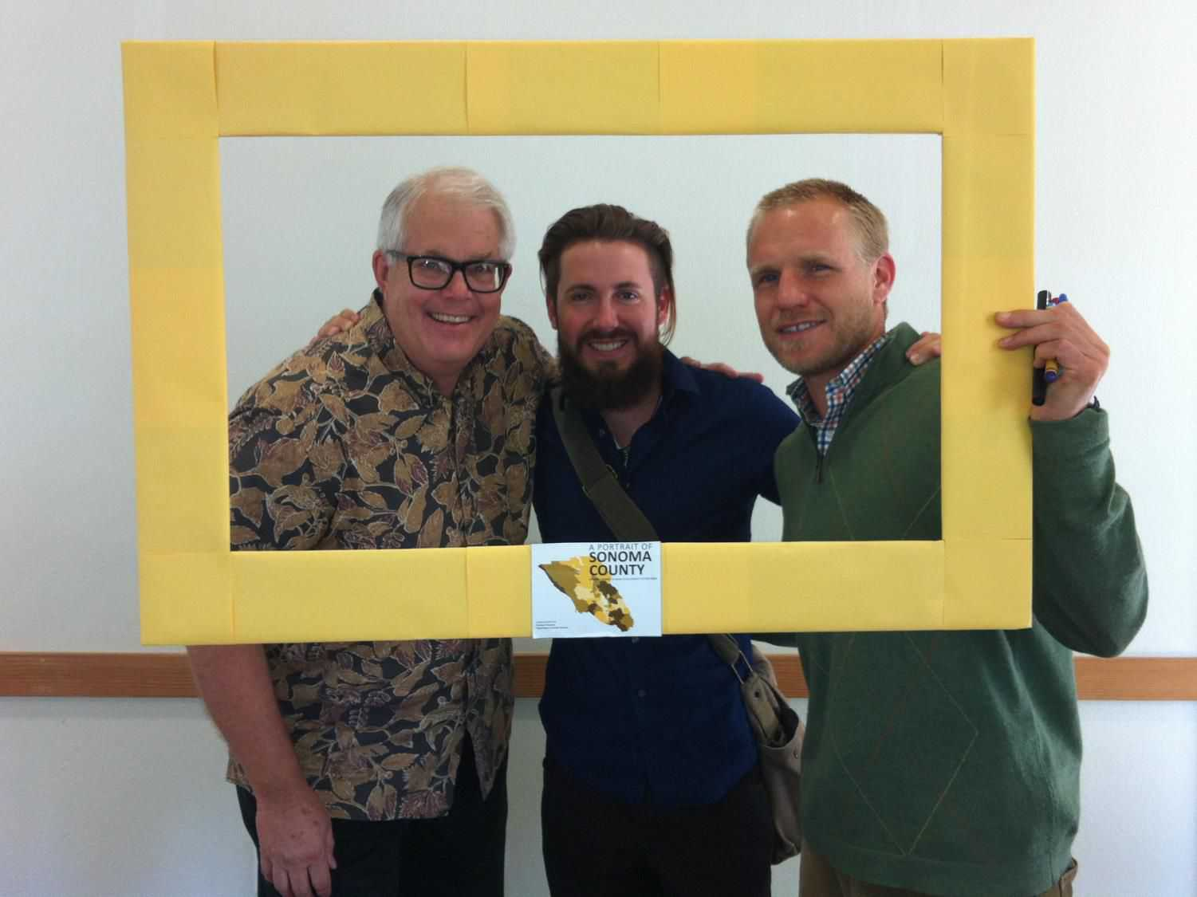
RRARA used the Portrait to identify Preschool Enrollment as an important local issue and is working to create more ECE opportunities.
RRARA (Russian River Area Resources and Advocates)

Slide 20
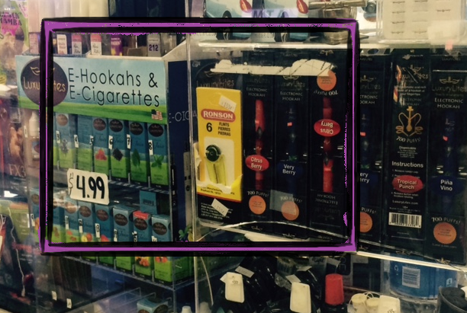
The Portrait data helps us identify key local challenges and opportunities. We are galvanizing our community to support the proposed County Tobacco Retail License (TRL).
Russian River Area Resources and Advocates (RRARA)

Slide 21
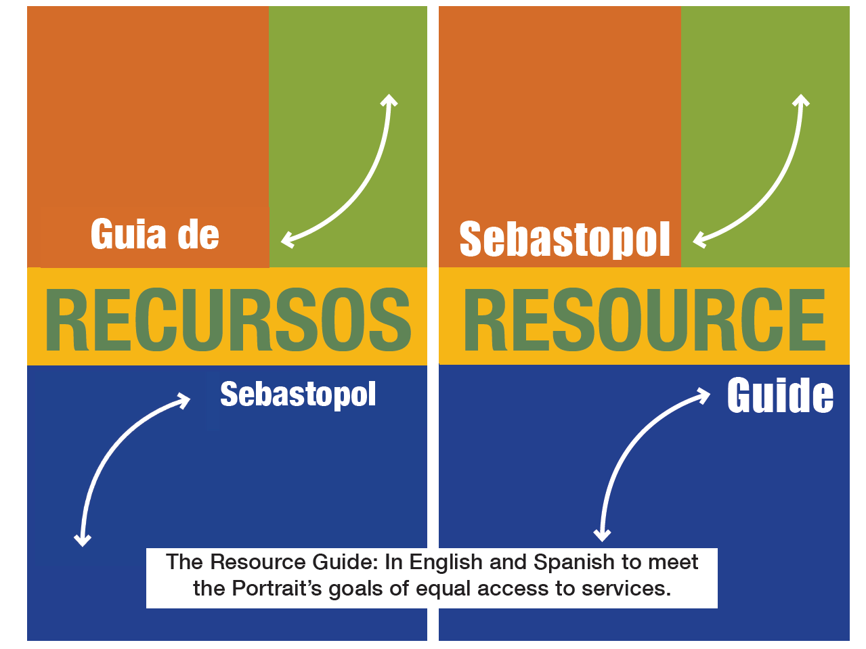
SACA created its resource guide in English and Spanish, aligned with the Portrait’s agenda to mend holes in the safety net
Sebastopol Area Community Alliance

Slide 22
TeensWork helps reduce youth disconnection by connecting teens with jobs and mentors, in alignment with the Portrait.
Sebastopol Area Community Alliance

Slide 23
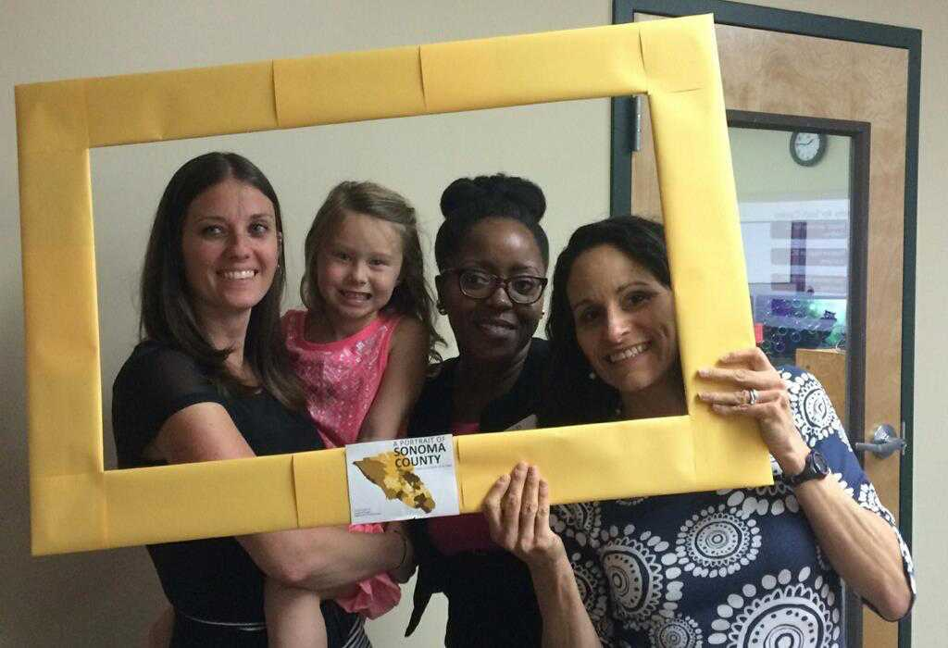
Cradle to Career used the Portrait to apply for support from ICS to develop innovative funding strategies for Early Childhood Education. We are now one of five communities in the nation to get their help!
Institute for Childhood Success Technical Assistance Team

Slide 24
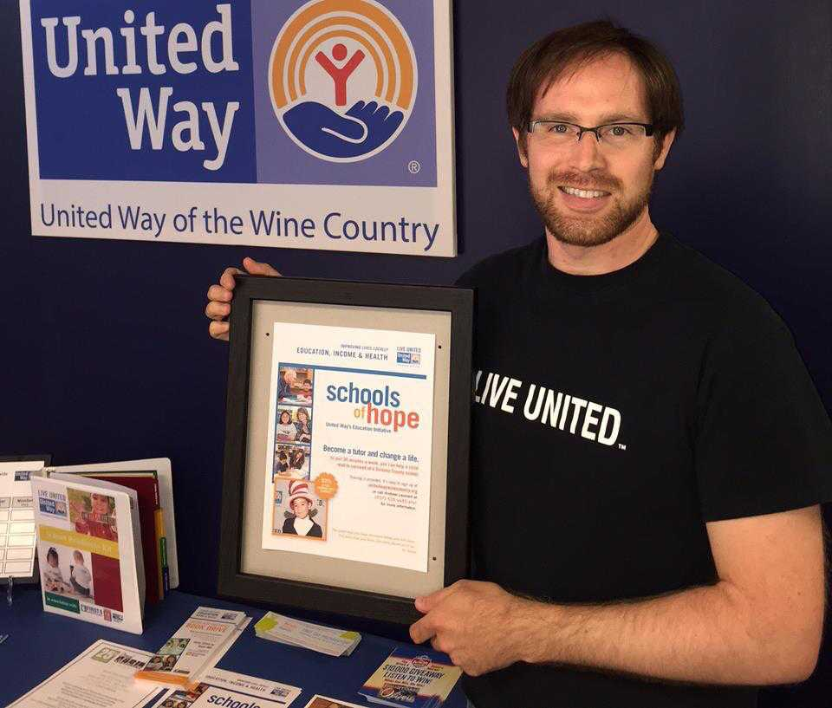
United Way of the Wine Country used the Portrait to confirm the current locations and inform the expansion of our Schools of Hope program. SOH also aligns with the Portrait’s recommendation to reduce youth disconnection.
Andrew Leonard, United Way of the Wine Country

Slide 25
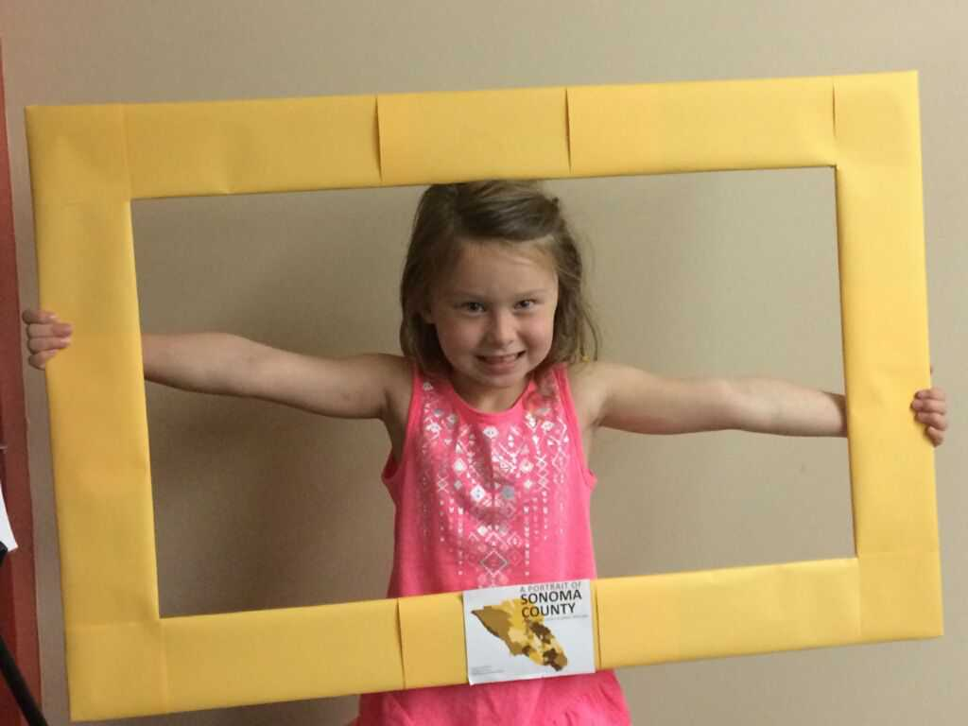
The Portrait was instrumental in the Board of Supervisors’ decision to fund First 5 to create a Preschool Facilities Grant Program, ensuring that there are enough slots for all us kids as we look toward Universal Preschool. Hailie Rosatti, Cradle to Career

Slide 26
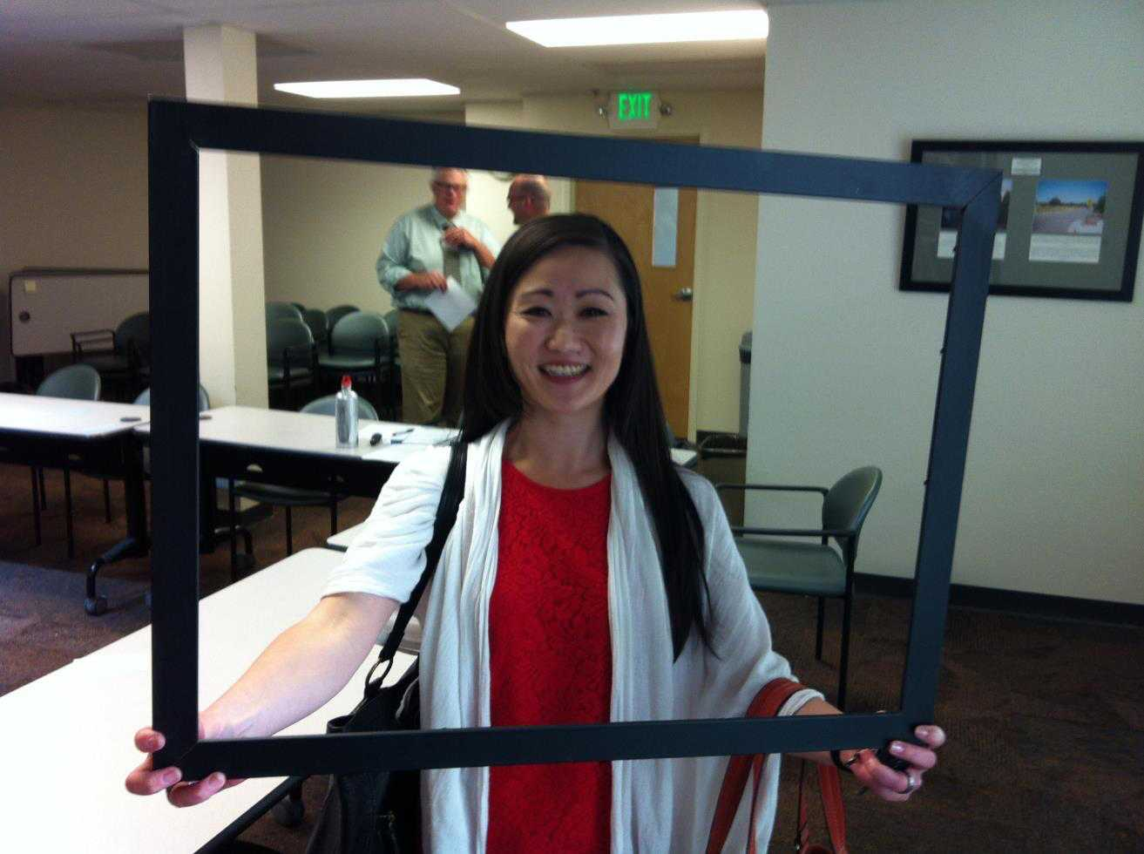
We’ve used the Portrait as an education tool, to apply for grants, as part of our strategic planning, and to inform our service strategy.
Lisa Badenfort, Ag Innovations Network and the Food System Alliance

Slide 27
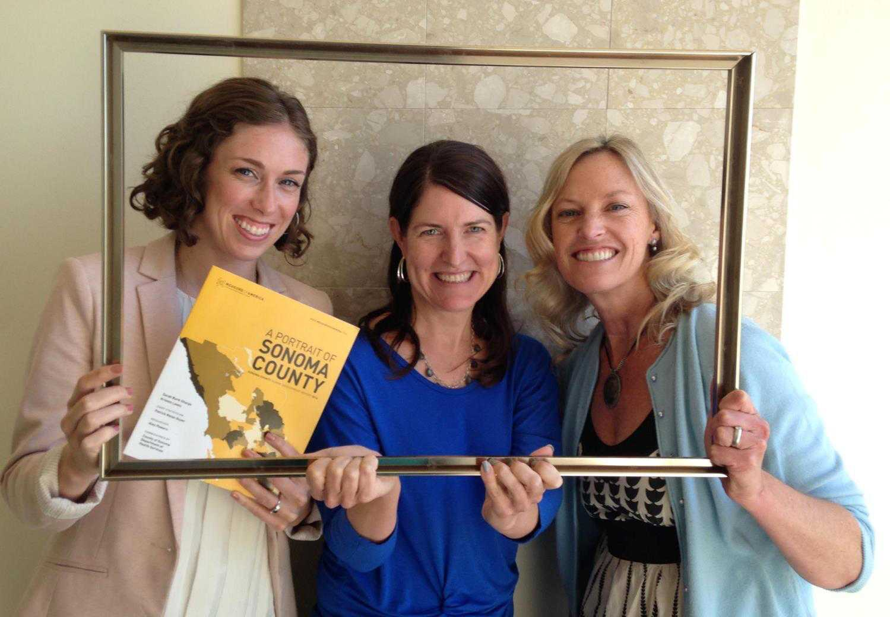
We’re using the Portrait to inform our investment decisions, recently funding the iREAD campaign. Community Foundation Sonoma County.
Elly Grogan, Beth Brown, & Karin Demarest, Community Foundation Sonoma County

Slide 28
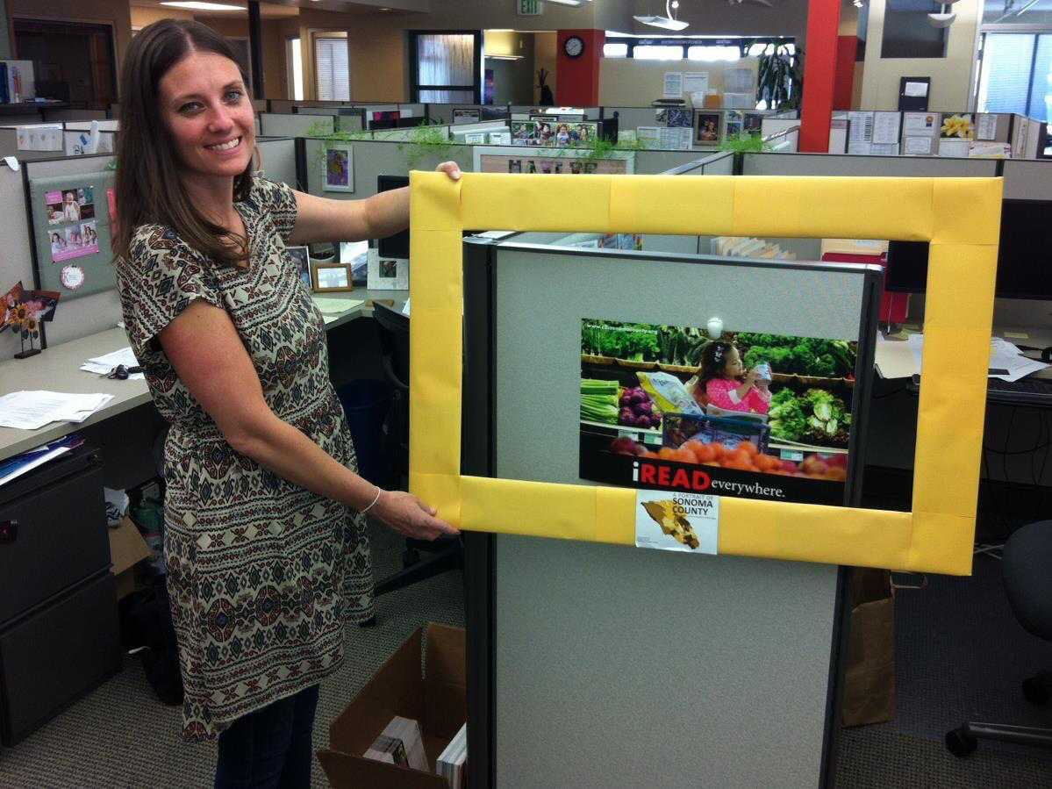
The Portrait reinforces C2C’s focus on Early Childhood Education. The iREAD campaign is one of four initial strategies to help children start school ready to succeed. Cradle to Career

Slide 29
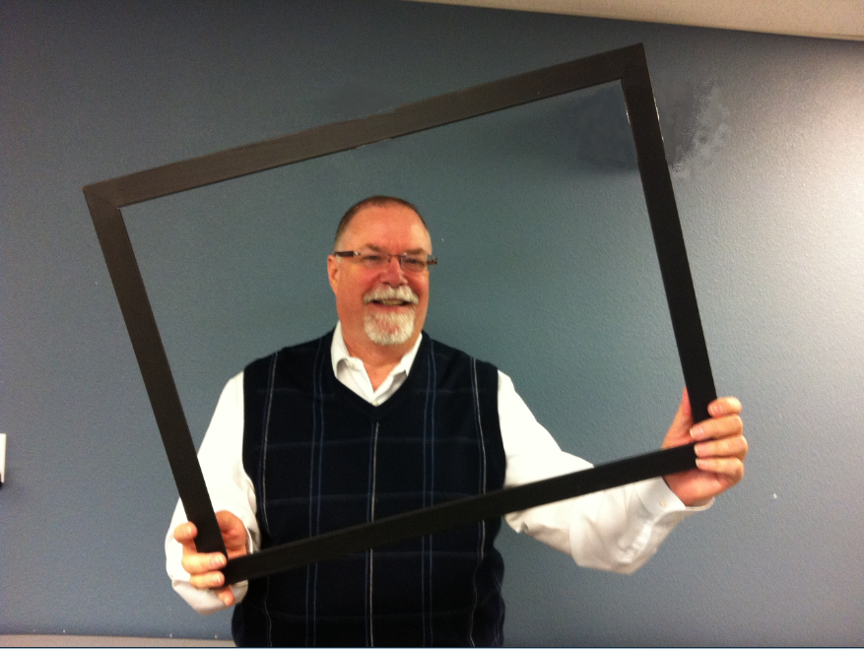
The Portrait has helped us with grant applications, strategic planning, program development, unify perspectives internally, and better understand the community. Tim Reese, Community Action Partnership of Sonoma County

Slide 30
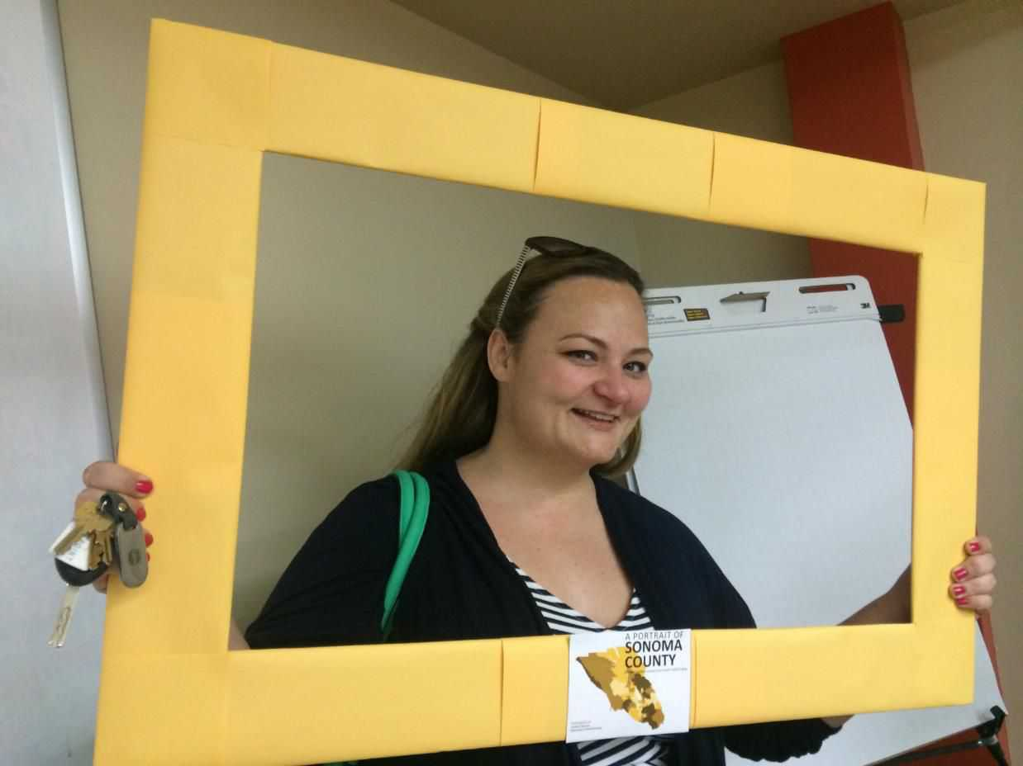
We’re using the Portrait to align our funding mechanisms to our priority projects in the community.
Jenny Symons, DHS Administration

Slide 31
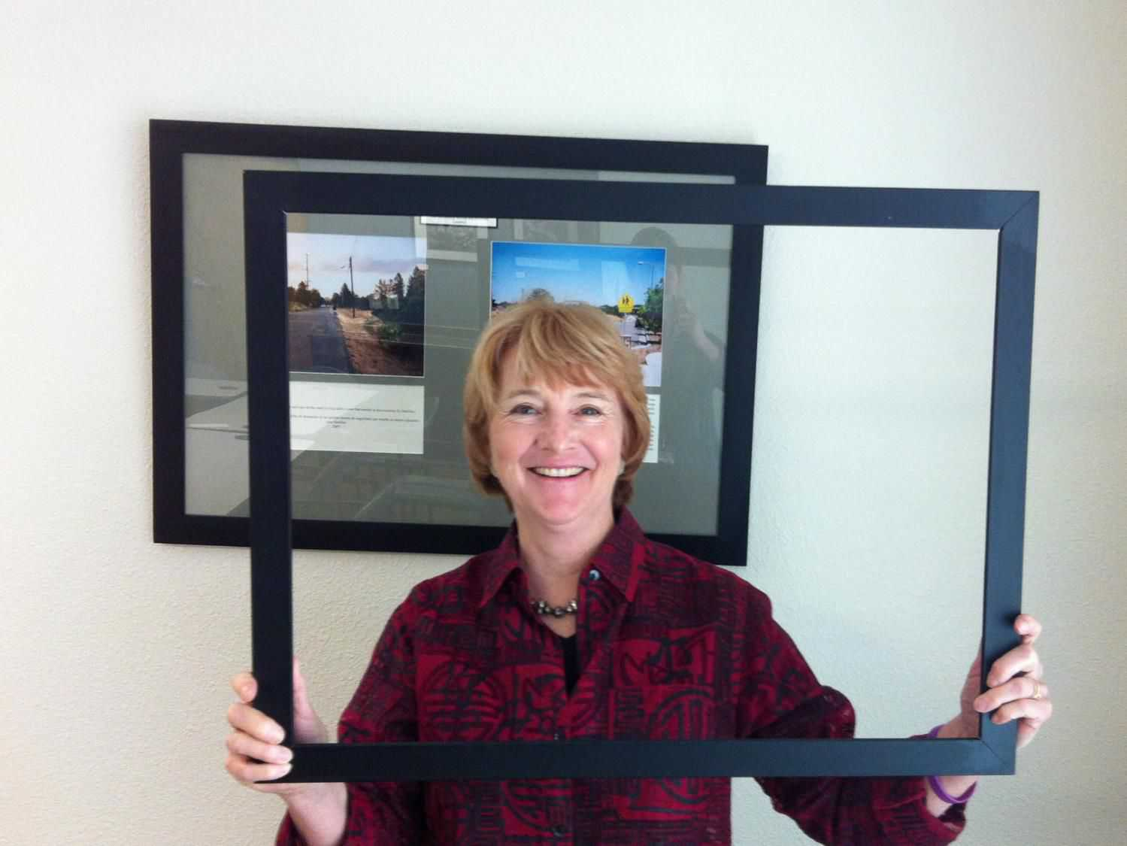
RCHC uses the Portrait to inform strategies at several health centers
Mary Maddux-Gonzalez, Redwood Community Health Coalition

Slide 32
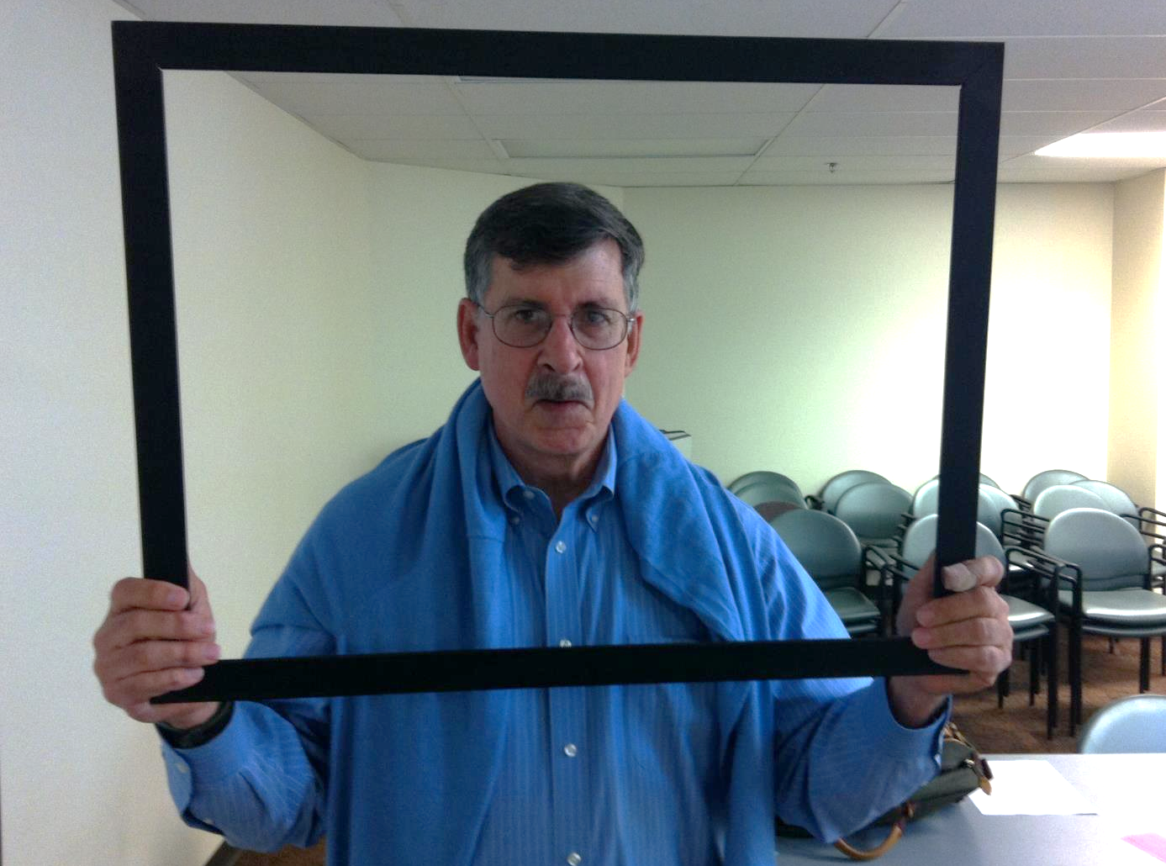
The Portrait helped us advocate for a $15/hour Living Wage Ordinance for the County and with public education for minimum and living wages.
Marty Bennett, North Bay Jobs With Justice

Slide 33
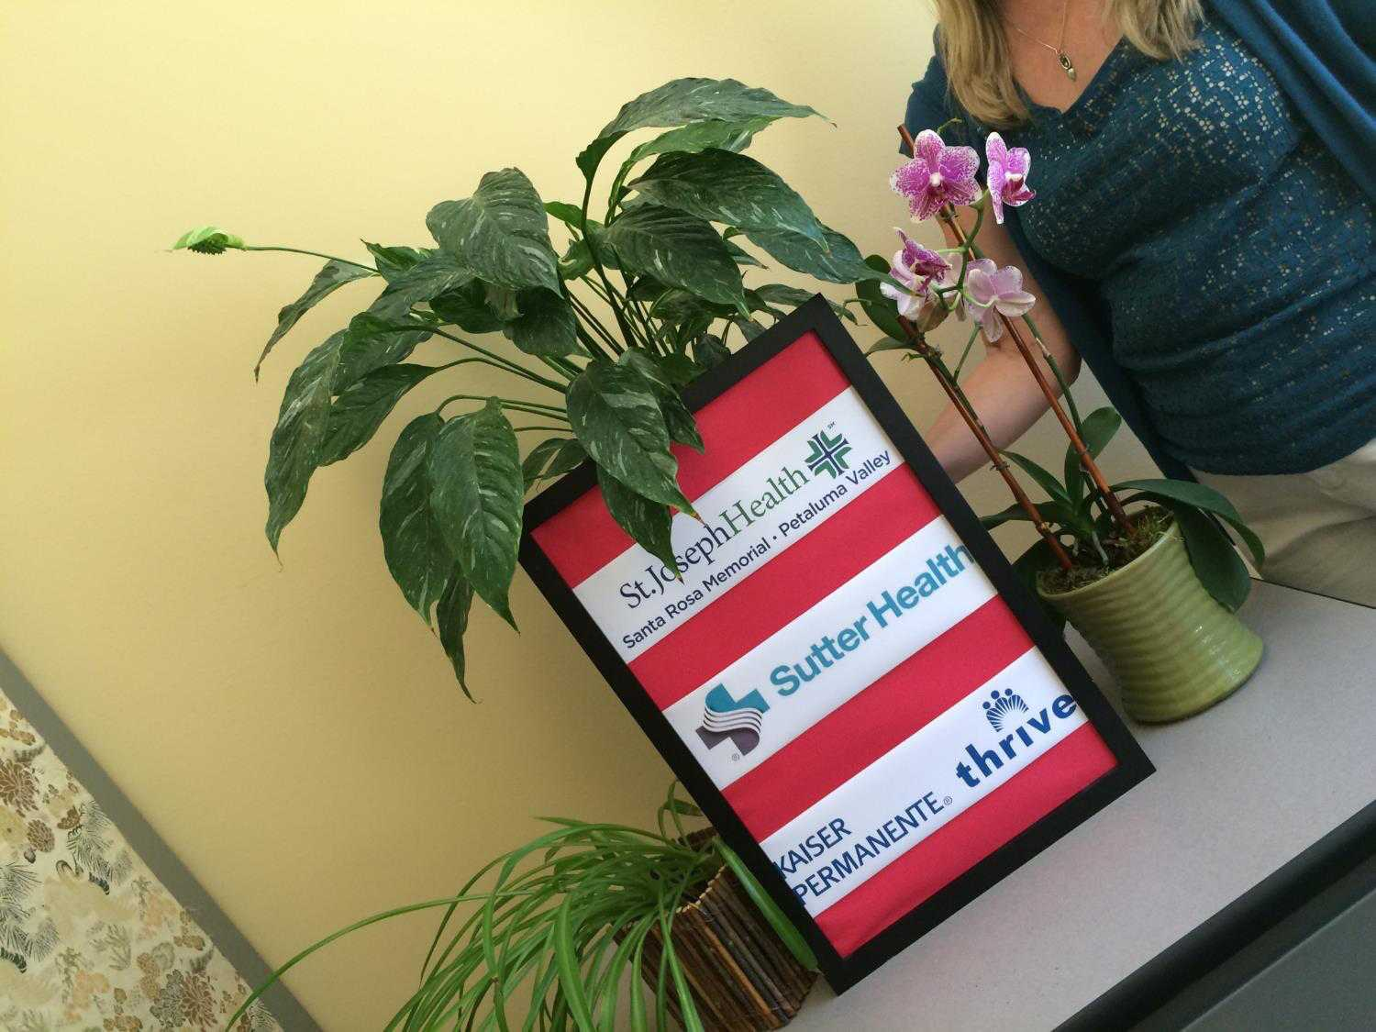
Sutter Health, Kaiser Permanente, and St. Joseph Health have committed to using the Portrait as a building block for their next 3-year Community Health Needs Assessment that is getting underway.

Slide 34
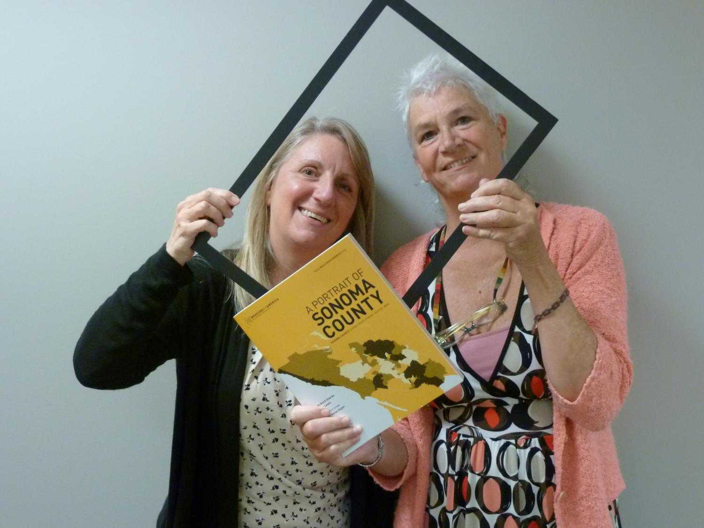
We ask grantees to use the Portrait data in their applications. We use the data to justify our health need priorities and help decide where we fund geographically.
Jeannie Dulberg and Shan Magnuson, Kaiser Permanente Community Benefit

Slide 35
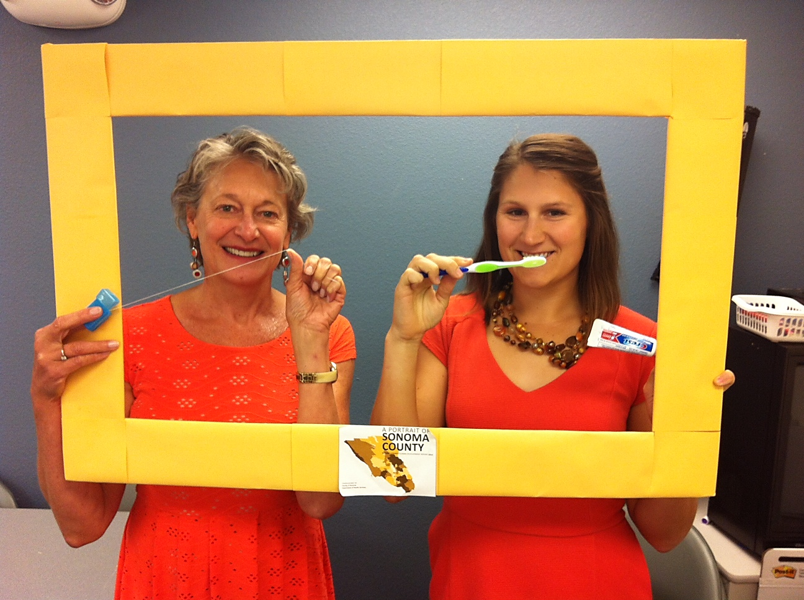
The County Dental Health Program focuses its activities in schools in the Portrait Priority Areas.
Kim Caldewey and Kristin Fladseth, Dental Health Program, DHS HPPE

Slide 36
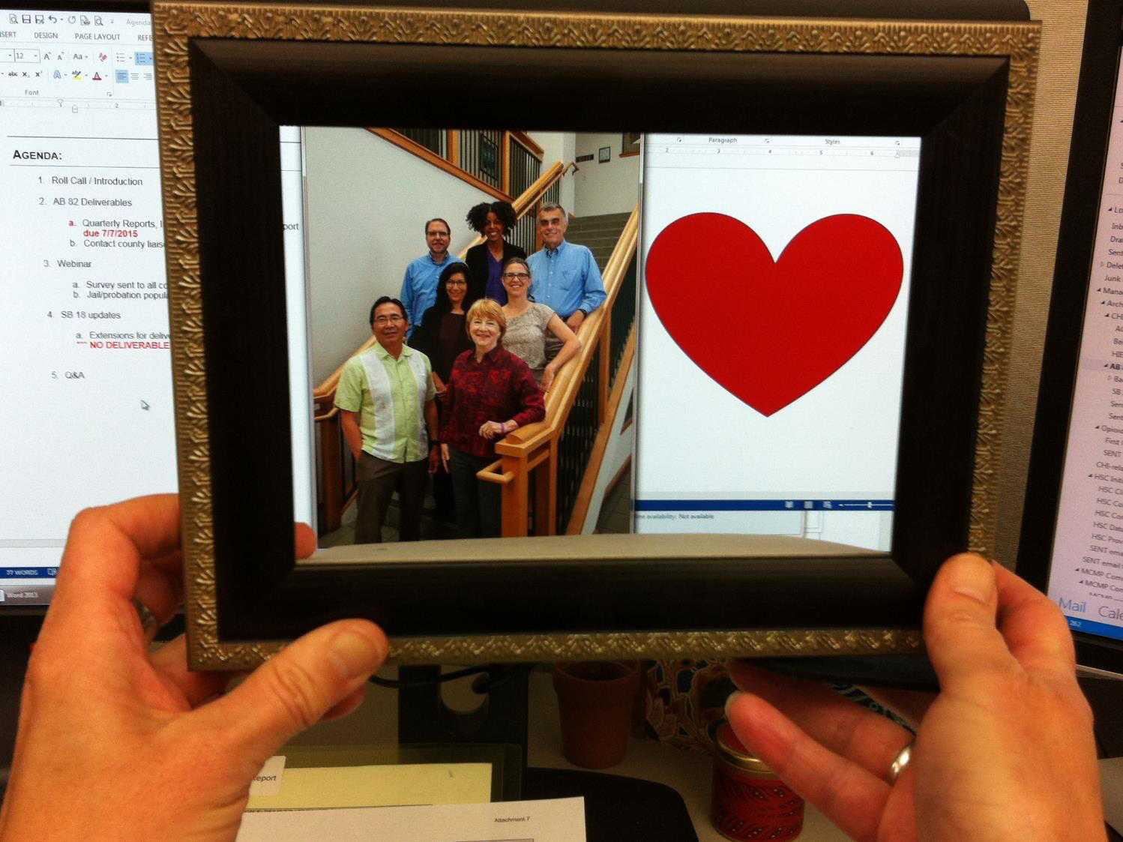
The Portrait will help us target our outreach efforts to improve cardiovascular health for all people in Sonoma County.
Hearts of Sonoma County Group, Committee for Healthcare Improvement

Slide 37
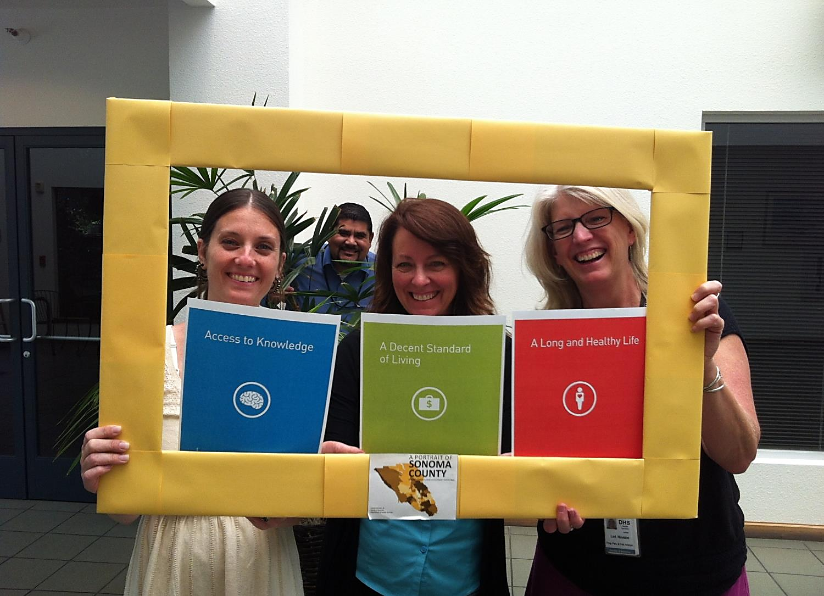
Health Action’s priority areas align with the Portrait’s dimensions of health, education, and income. Kellie Noe, Pamela Swan, and Lori Houston: Health Action Backbone Team (and Oscar Chavez infusing Upstream principles)

Slide 38
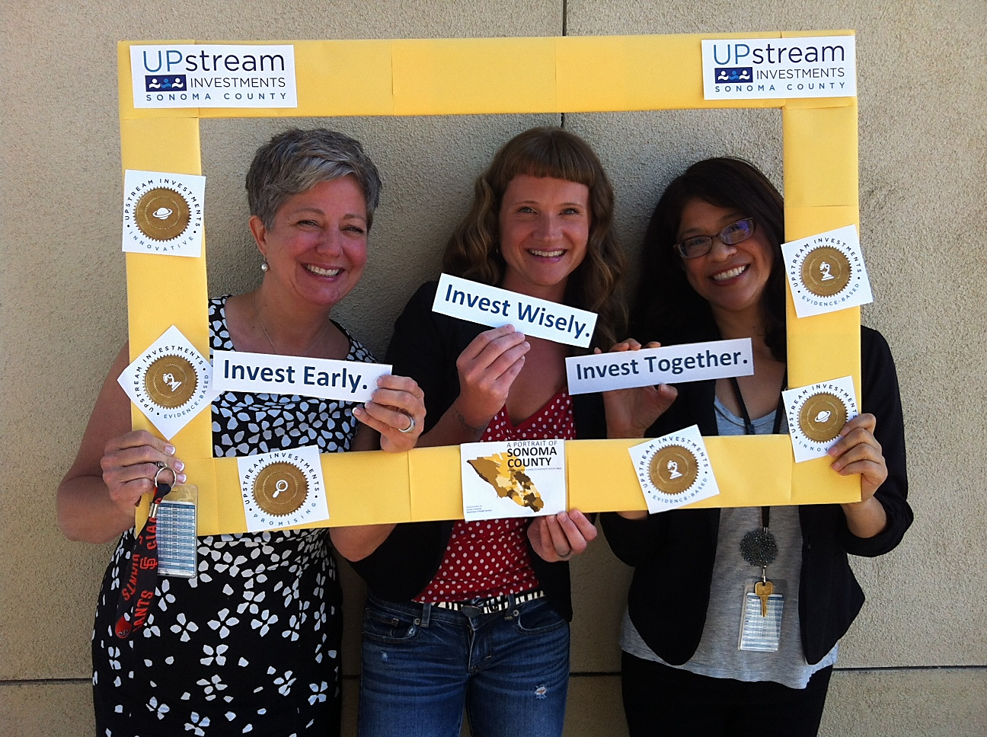
Upstream Investments uses the Portrait to prioritize technical assistance and as a tool for Upstream Portfolio applicants.
Angie Dillon-Shore, Joni Thacher, and Liz Parra
Upstream Investments Backbone Support Team, Human Services

Slide 39
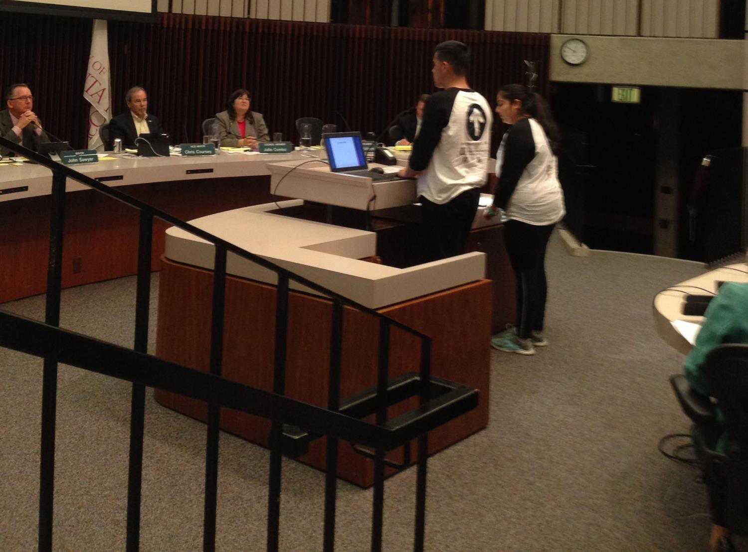
We referenced the Portrait and first hand experiences when advocating for a stronger smoke-free multi unit housing ordinance in Santa Rosa.
Miguel Garduño and Andrea Magaña, Project TRUE, Center for Well-Being

Slide 40
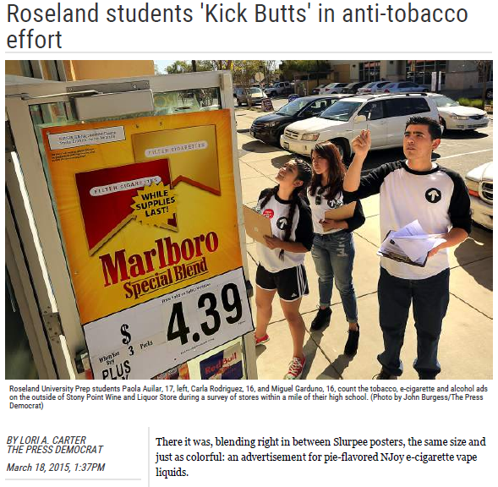
The Portrait supports the Northern California Center for Well-Being’s focus on tobacco prevention and also their decision to site Project True at Roseland University Prep. Paola Aguilar, Karla Rodriguez, and Miguel Garduño,
Project TRUE, Center for Well-Being

Slide 41
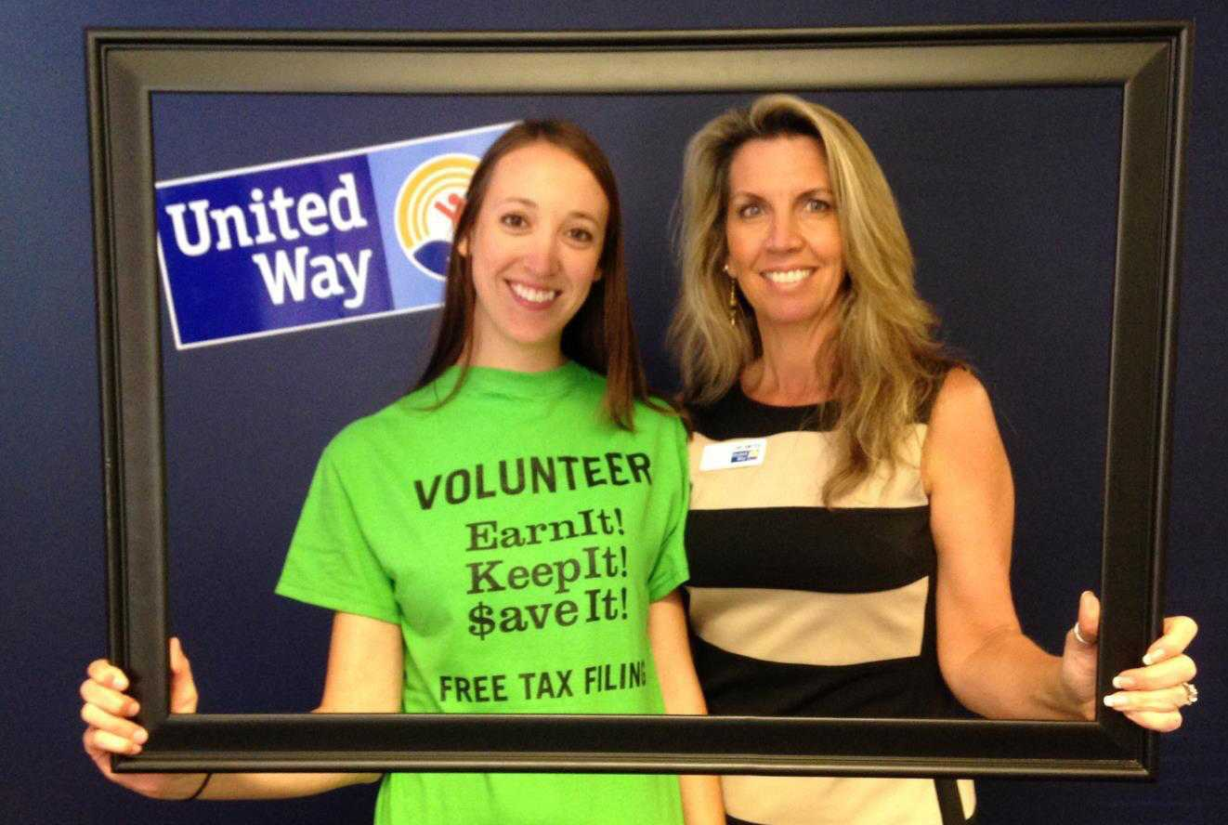
United Way of the Wine Country used the Portrait to help target locations and outreach for the Earn It! Keep It! Save It! program. EKS also aligns with the Portrait's recommendation to raise earnings and incentivize savings.
Suzanne Yeomans and Michelle Fielder, United Way of the Wine Country

Slide 42
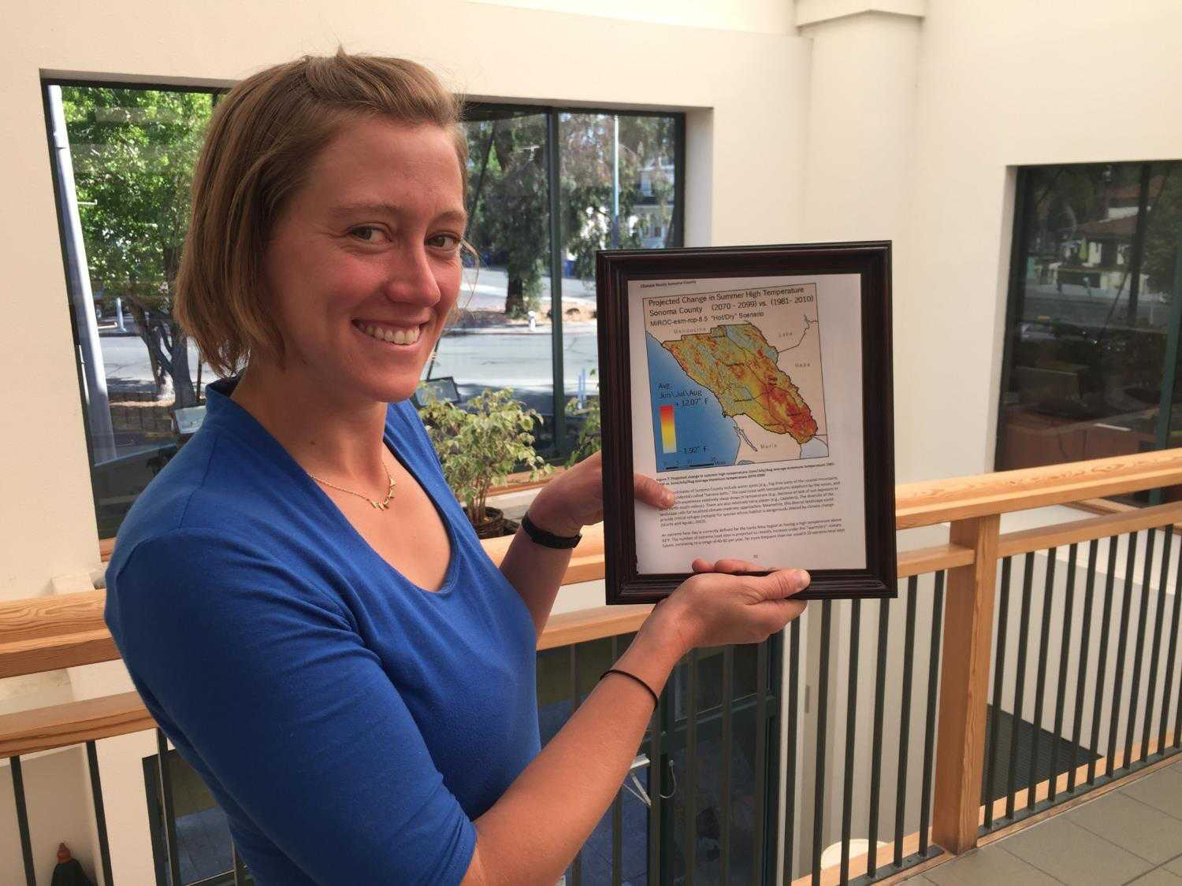
All people in Sonoma County are at risk from climate change, but some are more vulnerable than others. The Portrait data give us a framework to understand how local hazards like heat, fire, and flood will affect various communities disproportionally.
Lauren Casey, Regional Climate Protection Authority

Slide 43
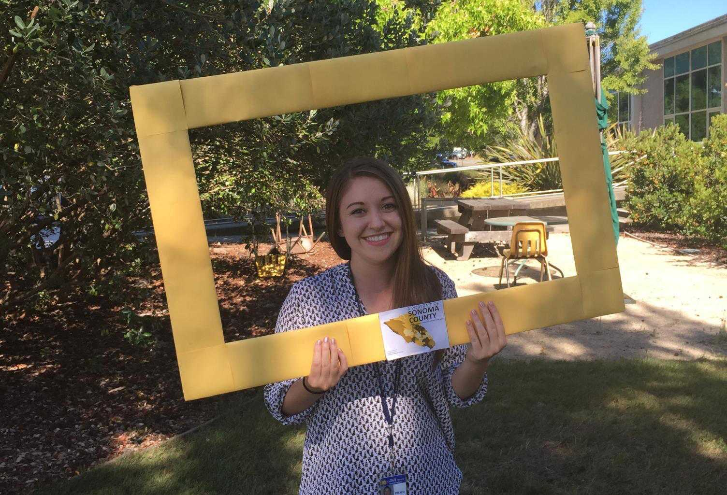
I learned about the Portrait in my Healthy Communities class at SSU. It will be helpful to me as I begin my career in community planning.
April Gunderson, SSU Environmental Studies and Planning Graduate

Slide 44
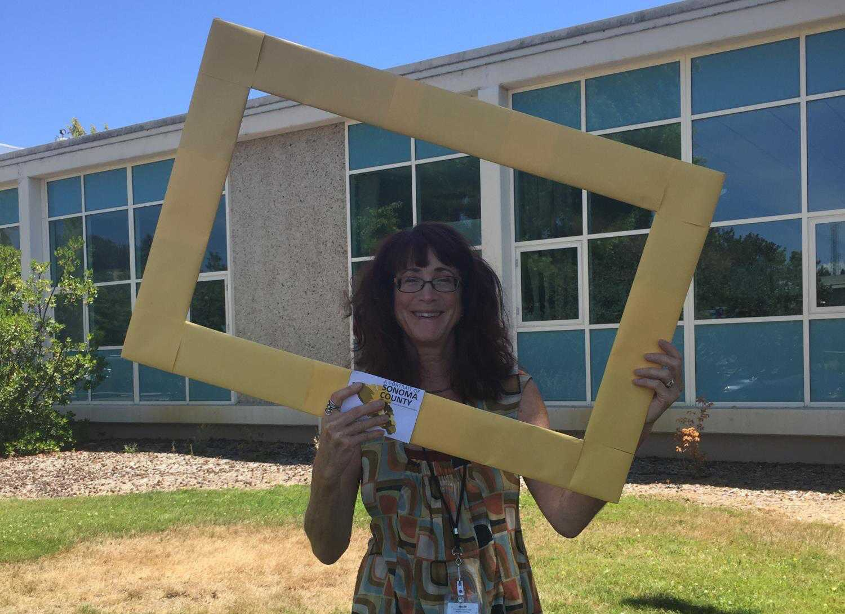
The Permit and Resource Management Department used the Portrait to identify and adopt “Communities of Concern” within the General Plan Land Use Element. Lisa Posternak, County PRMD

Slide 45
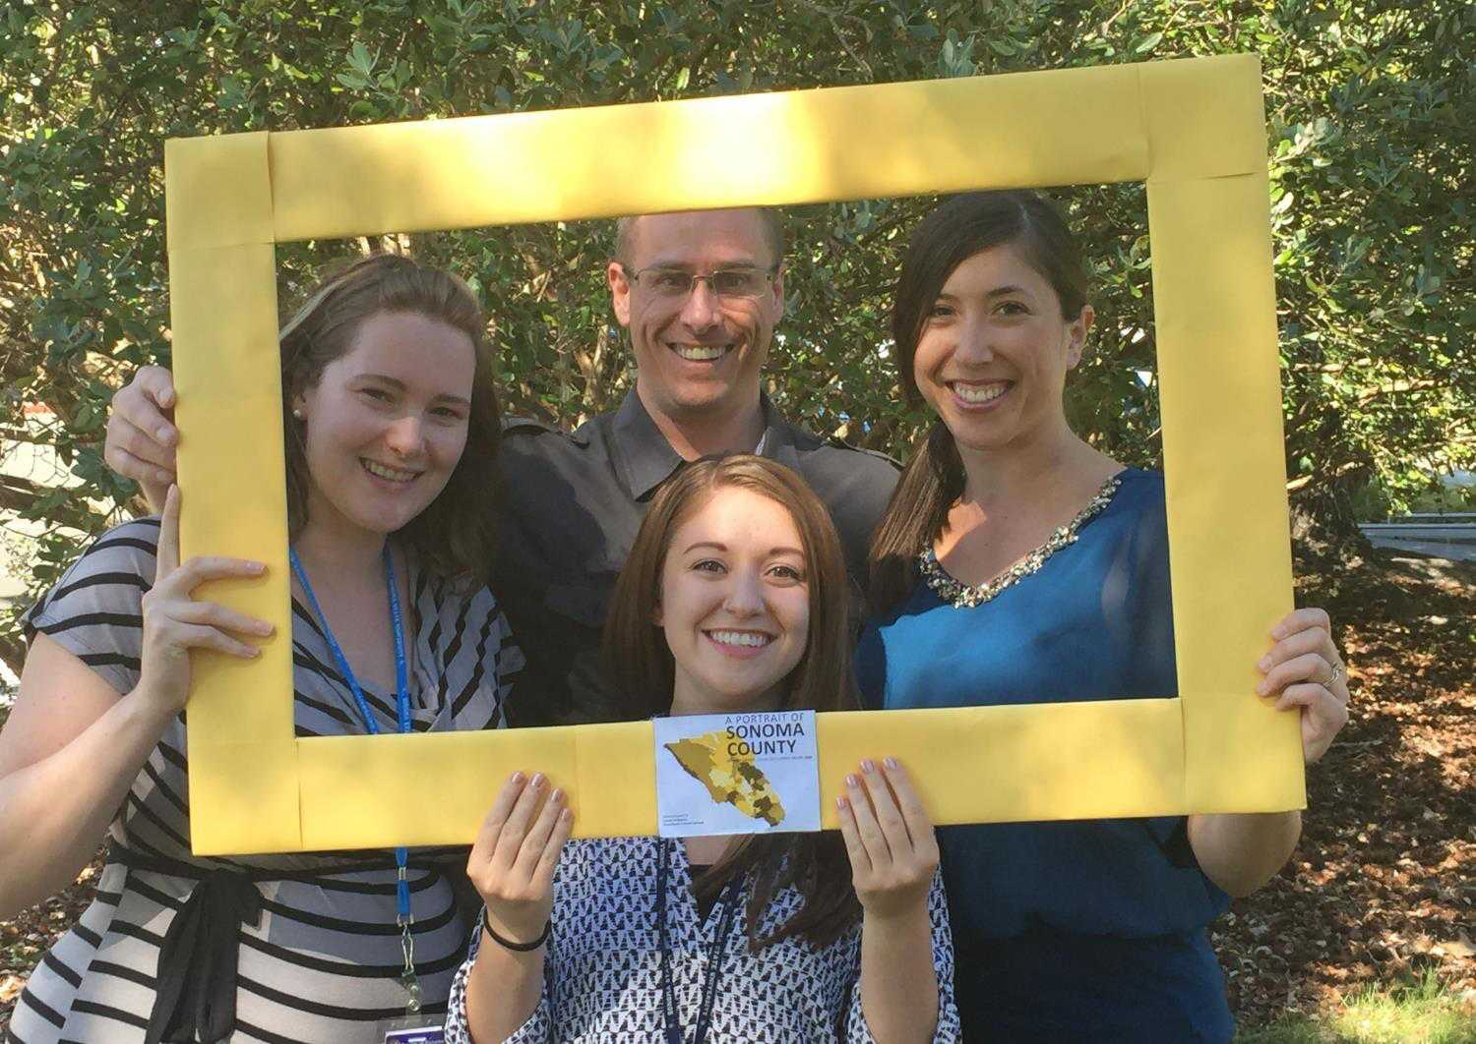
We use the Portrait to review health information by neighborhood for policy recommendations.
Sonoma County Permit and Resource Management Department

Slide 46
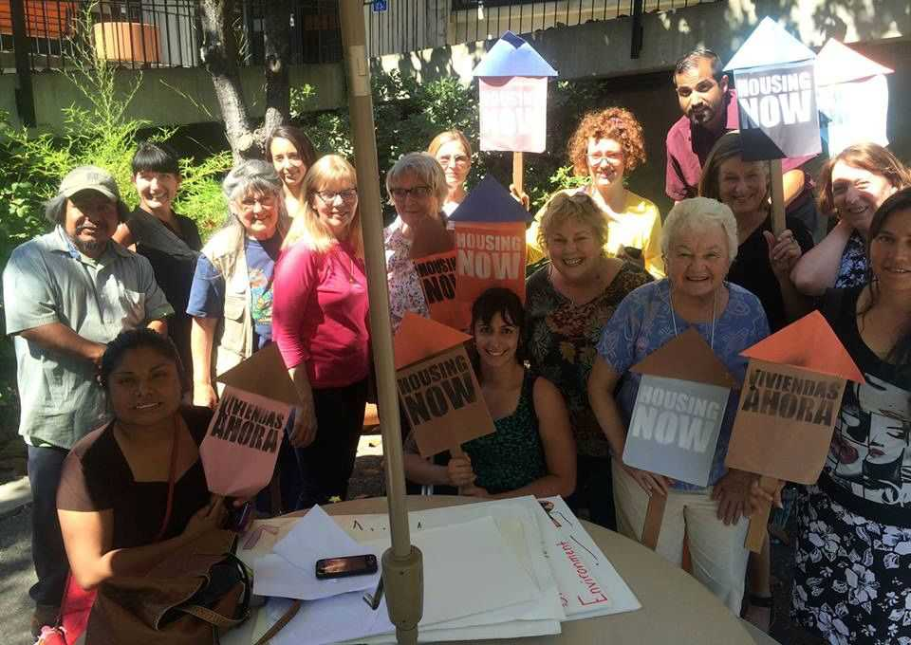
The Portrait helped us identify regions in severe need of community organizing around tenant protections, and helped us make the case for rent stabilization policies and affordable housing
North Bay Organizing Project

Slide 47
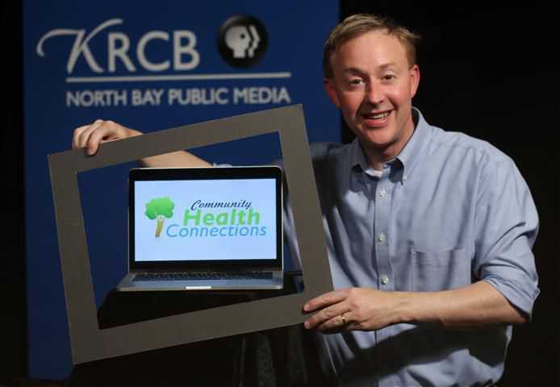
KRCB uses the Portrait to develop content (topic and place related) for its Health Connections TV shows, on-air videos, and radio stories that both inform and connect people in Sonoma County.
Darren LaShelle, KRCB Content Manager, krcb.org/health

Slide 48
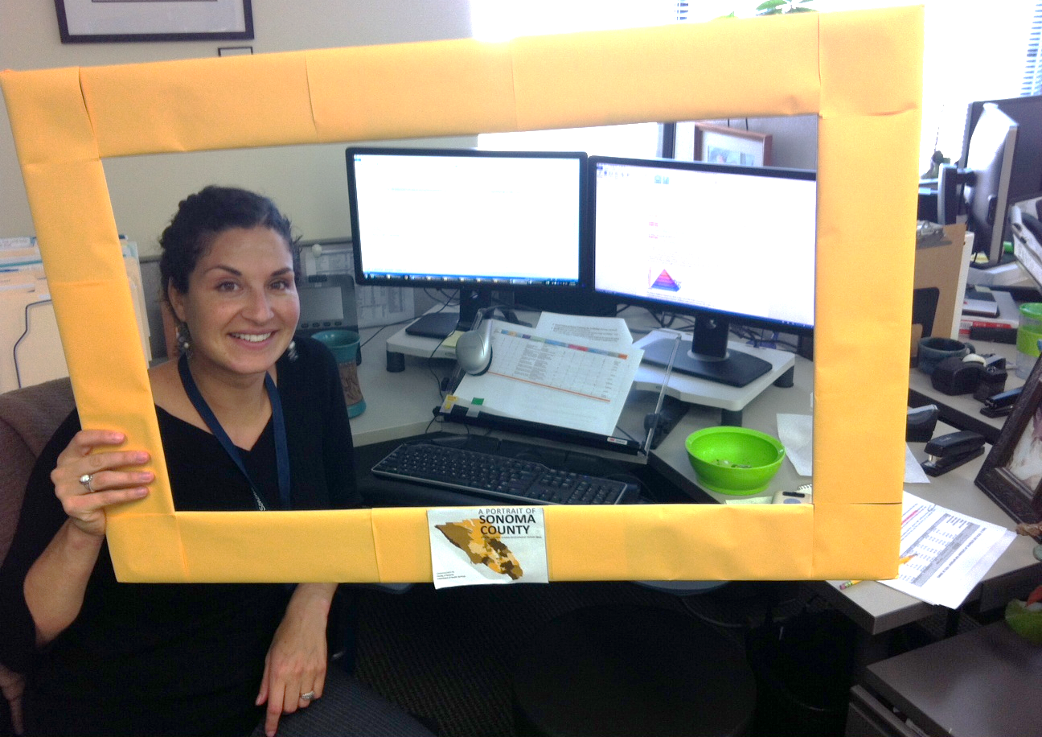
Portrait data and findings support efforts to assess violence locally and to develop a strategic prevention initiative.
Alea Tantarelli, Violence Prevention, DHS HPPE

Slide 49
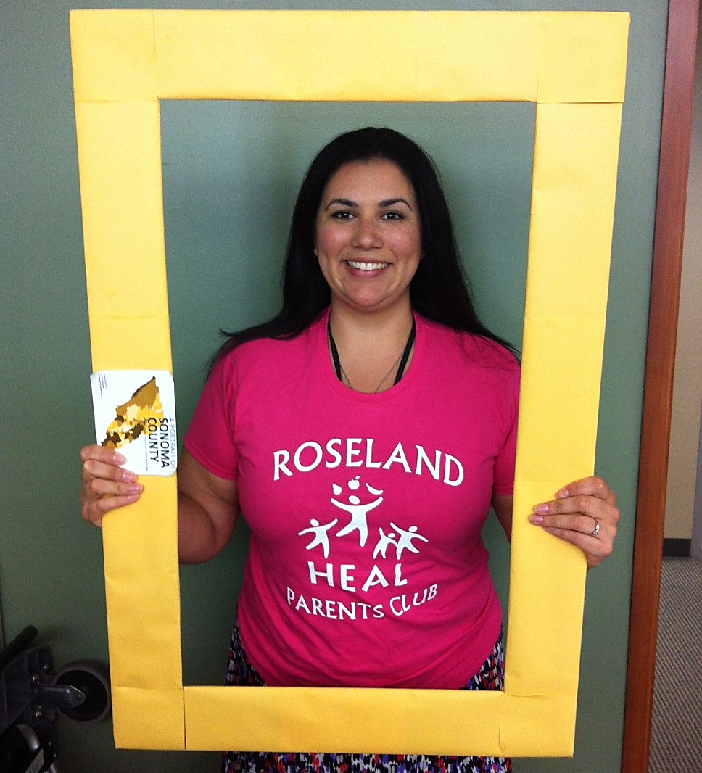
HEAL (the Healthy Eating, Active Living Zone Program) focuses on the Roseland neighborhood, the area identified by the Portrait as having the greatest unmet potential. Danielle Ronshausen, HEAL Coordinator, DHS HPPE

Slide 50
The Communities of Excellence (CX³) community leaders use the Portrait to help create healthier retail environments in their neighborhoods to improve access to fresh fruits and vegetables, and healthier beverages. Nohemi, Reyna, and the Hiatt girls, CX3 Community Leaders

